Slide 1
Regression
Chad Williams
University of Victoria

Slide 2
Lecture Outline
Regression Conceptually
Computing Regression Lines
Standard Error of the Regression Line
Explained Variability
Formal Report

Slide 3
Lecture Outline
Regression Conceptually
Computing Regression Lines
Standard Error of the Regression Line
Explained Variability
Formal Report

Slide 4
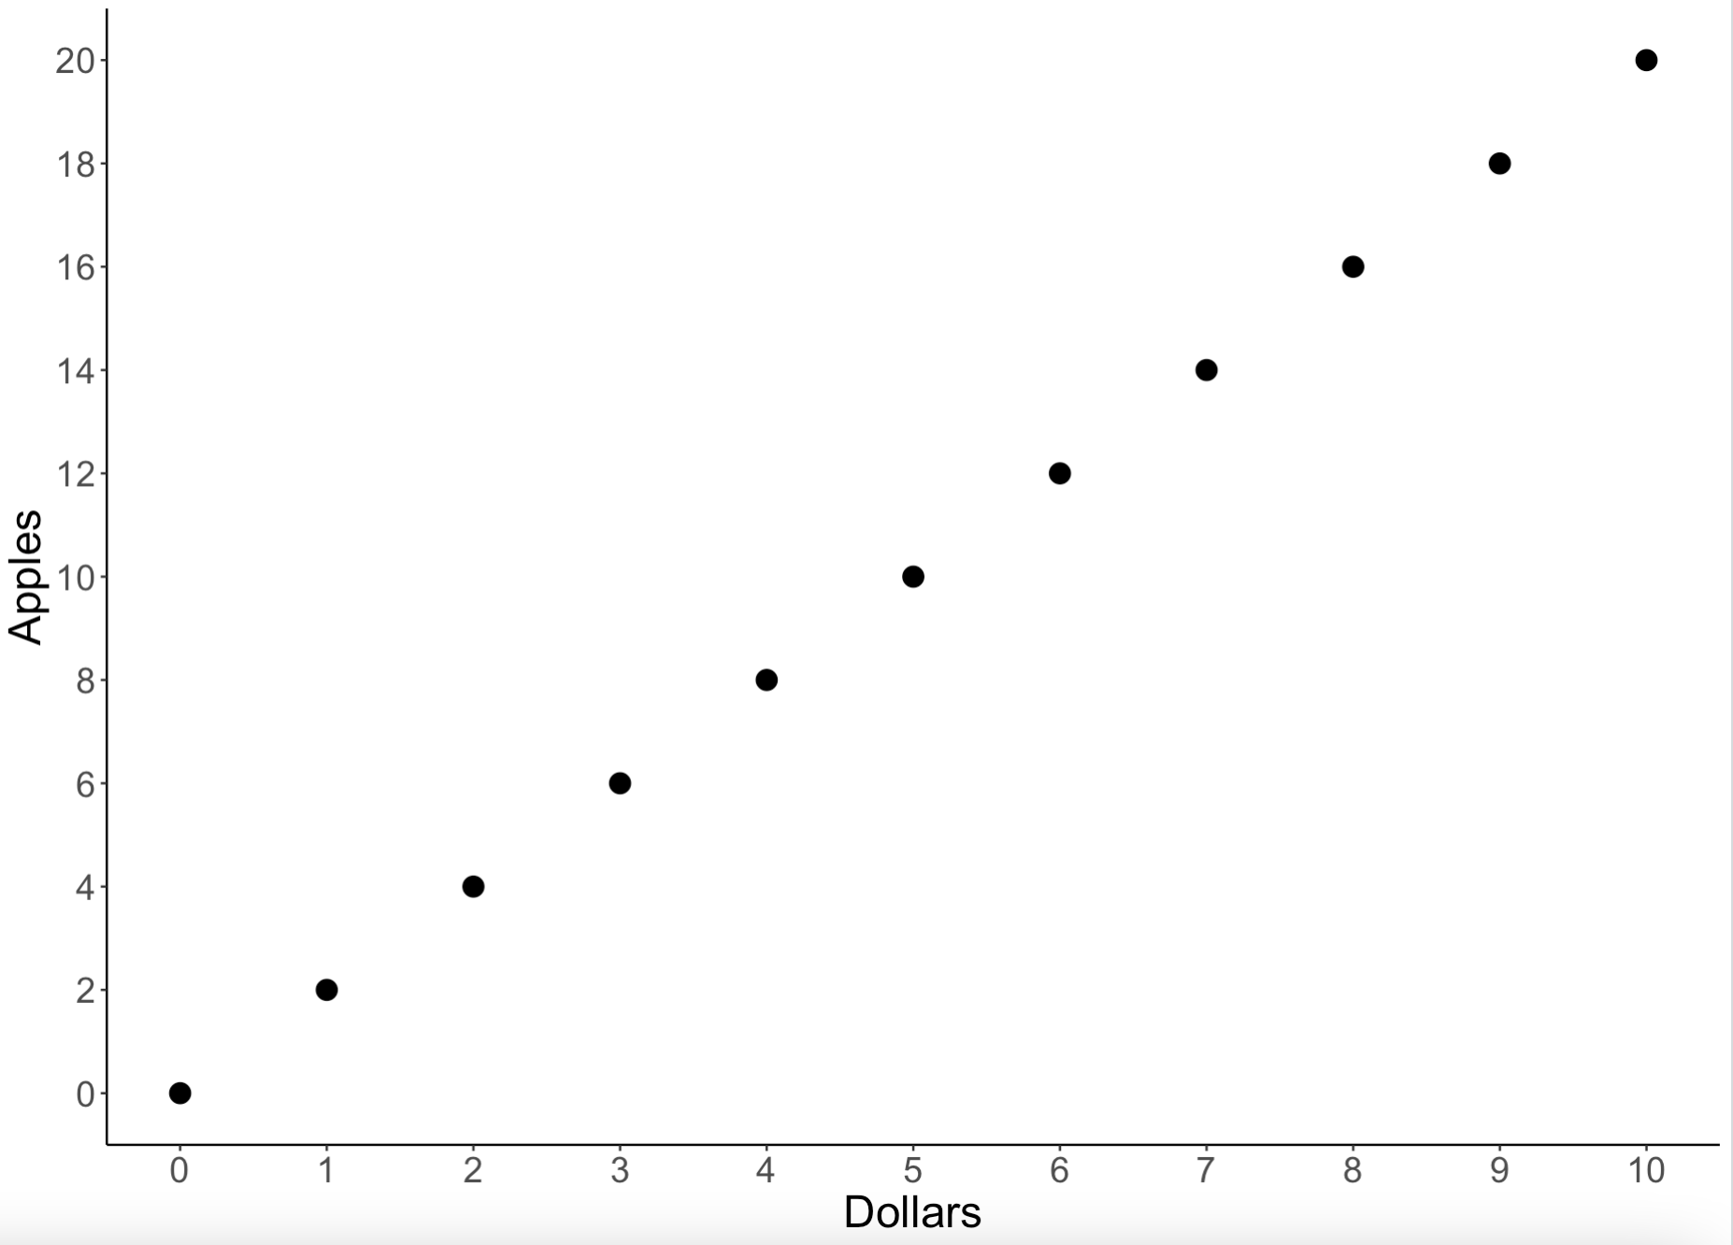
Regression Conceptually
Regression allows us to predict a variables score (e.g., a y-value) from a score on another variable (e.g., an x-value)
A mathematically defined line that best represents the bivariate relationship

Slide 5
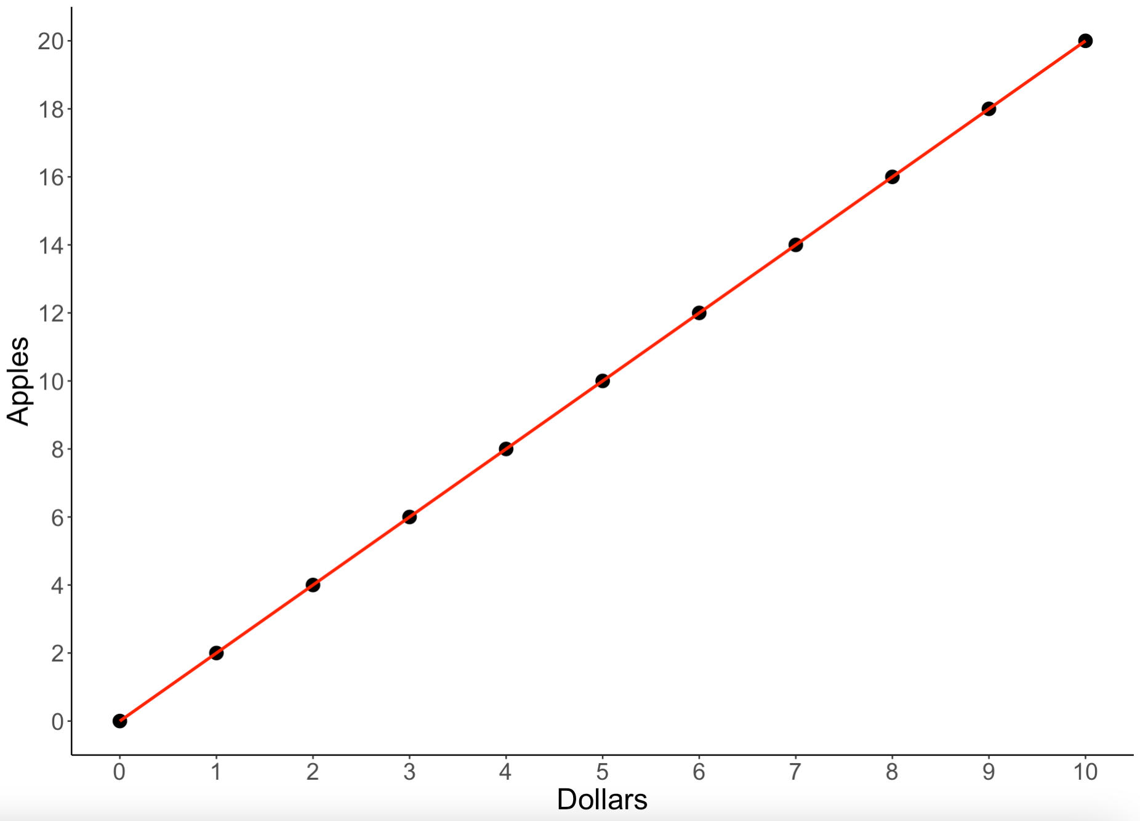
Regression Conceptually
One dollar gets you two apples
How many apples does five dollars get you?
How many apples does zero dollars get you?

Slide 6
Regression Conceptually
Slope: How much one variable changes when another variable increases by 1
1 dollar (x) gets you 2 apples (y)
So, the slope is 2
How many apples does five dollars get you?
2 apples per dollar (slope) means we would have 10 apples

Slide 7
Regression Conceptually
Y-Intercept: How much of one variable do you have in the absence of the other
How many apples does zero dollars get you?
Without any dollars, you can’t buy any apples

Slide 8
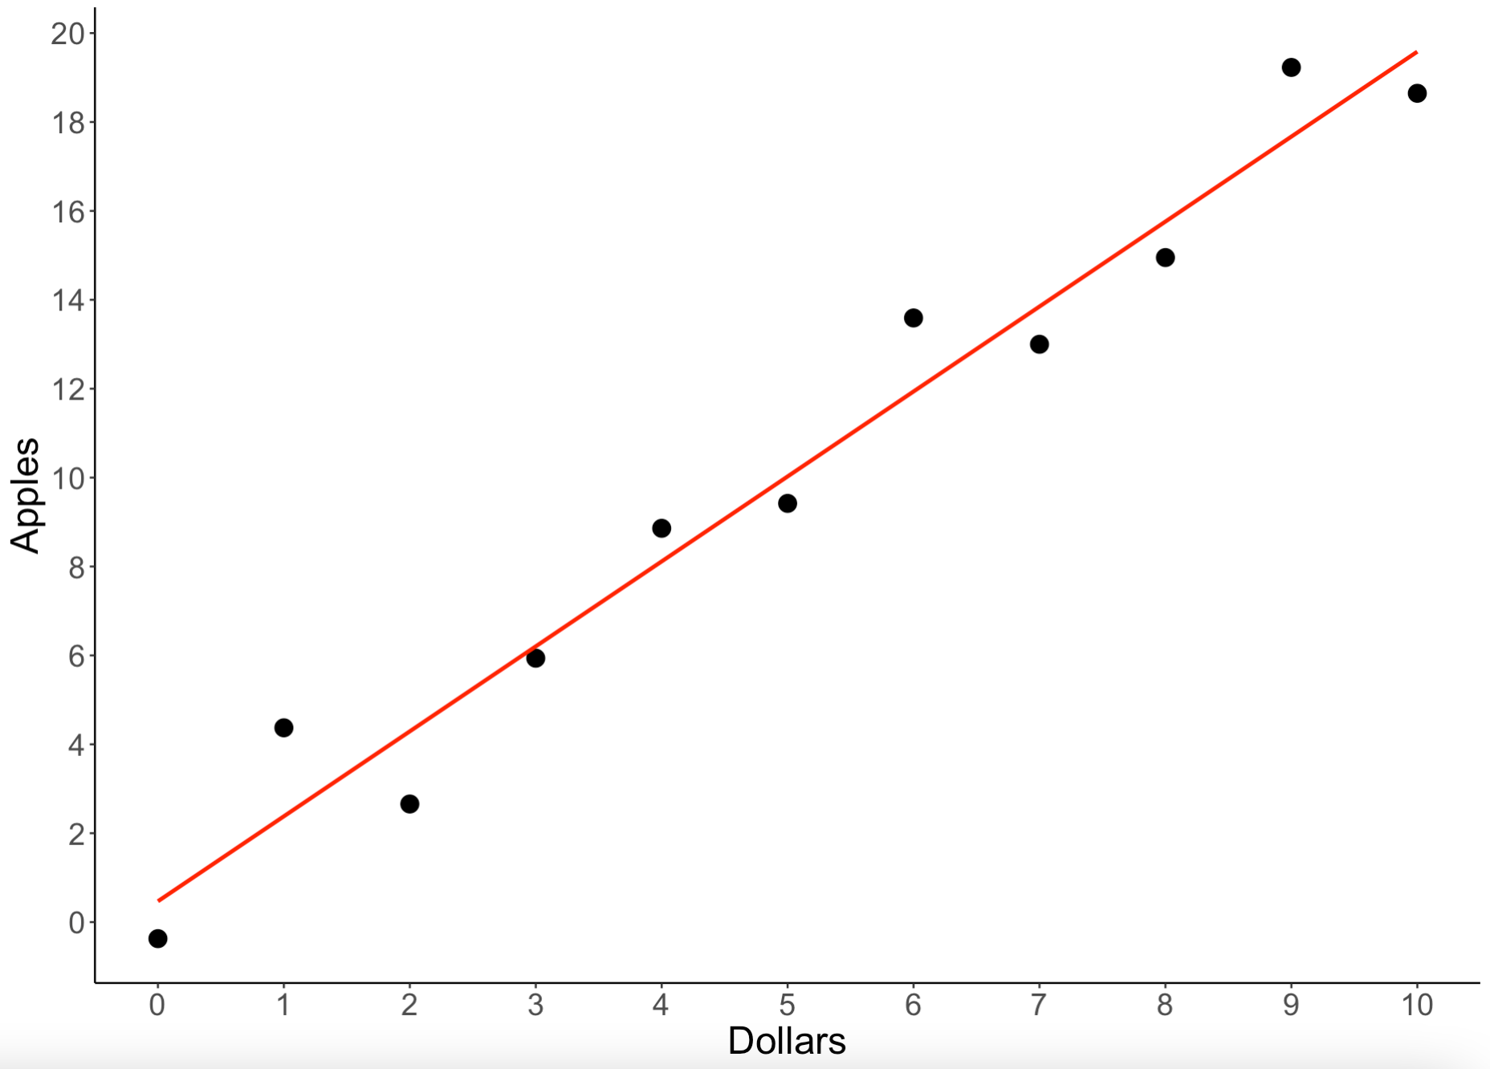
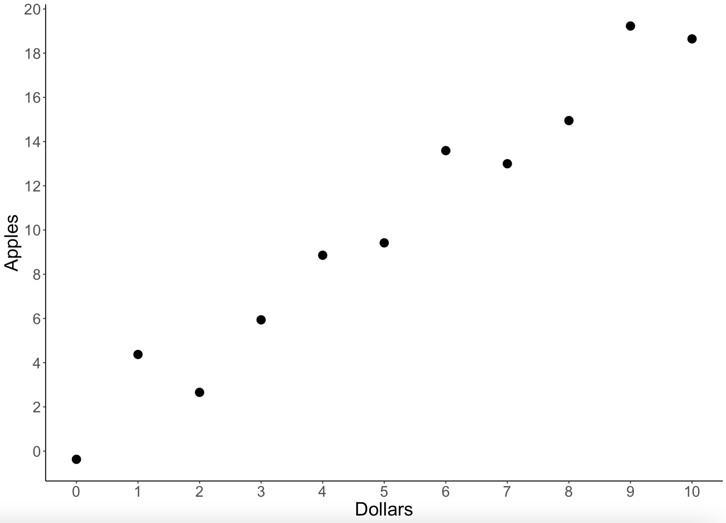
Regression Conceptually
Error in Regression: Although we can come up with a very good prediction of Y from X, variability in our data makes it unlikely that we will find a perfect prediction
E.g., the price of apples change depending on the day, store, type of apple, etc.

Slide 9
Regression Conceptually
Explained Variability: How close our predictions are from the actual value
In other words, how well have we predicted one variable from the other
Unexplained Variability: How far our predictions are from the actual value
In other words, how poorly we predicted one variable from the other

Slide 10
Regression Conceptually
The regression line is denoted as Y’ and X’
Y’ = a_{y} + b_{y}X
X’ = a_{x} + b_{x}Y

Slide 11
Regression Conceptually
Y’ = a_{y} + b_{y}X
Y’ = Predicted y-values from the regression line
How many apples do you get based on how many dollars you have
a_{y} = Y-intercept
How much of Y when there is an absence of X
The y-value when X = 0
A constant in the equation that shifts the regression up or down

Slide 12
Regression Conceptually
Y’ = a_{y} + b_{y}X
b_{y} = Slope
How much Y-scores change across X-scores
How much Y changes for a single increase in X
A coefficient in the equation that changes the steepness of the relationship

Slide 13
Regression Conceptually
X’ = a_{x} + b_{x}Y
X’ = Predicted X-values from the regression line
E.g., how many dollars do you get if you sell one apple?
a_{x} = X-intercept
How much of X when there is an absence of Y
The x-value when Y = 0
A constant in the equation that shifts the regression left or right

Slide 14
Regression Conceptually
X’ = a_{x} + b_{x}Y
b_{x} = Slope
How much X-scores change across Y scores
How much X changes for a single increase in Y
A coefficient in the equation that changes the steepness of the relationship

Slide 15
Lecture Outline
Regression Conceptually
Computing Regression Lines
Standard Error of the Regression Line
Explained Variability
Formal Report

Slide 16




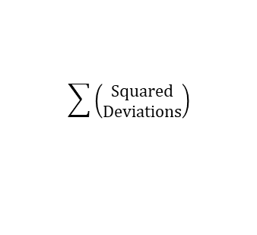
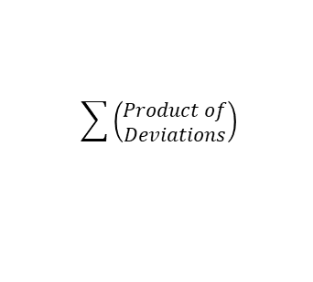

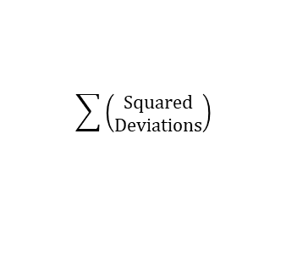


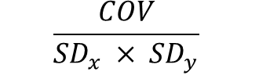



$$x − \bar{x}$$
$${deviations}^{2}$$
$$\sum{\left(\begin{aligned}Squared \\ Deviations\end{aligned}\right)}$$
$$\frac{SS}{n}$$
$$\sqrt{{SD}^{2}}$$
X
Deviations
Squared
Deviations
Sum of Squares
(SS)
Variance
(SD²)
Standard Deviation
(SDₓ)
$$\sum{\left(\begin{aligned}Product of \\ Deviations\end{aligned}\right)}$$
$$\frac{SP}{n}$$
$$\frac{COV}{{SD}_{x} × {SD}_{y}}$$
$$\left(x − \bar{x}\right)\left(y − \bar{y}\right)$$
Product of
Deviations
Sum of Products
(SP)
Covariance
(COV)
Correlation
(r)
$$y − \bar{y}$$
$${deviations}^{2}$$
$$\sum{\left(\begin{aligned}Squared \\ Deviations\end{aligned}\right)}$$
$$\frac{SS}{n}$$
$$\sqrt{{SD}^{2}}$$
Y
Deviations
Squared
Deviations
Sum of Squares
(SS)
Variance
(SD²)
Standard Deviation
(SDᵧ)

Slide 17
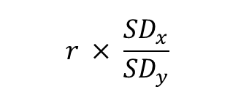
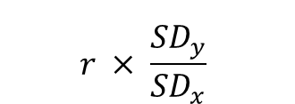
$$x − \bar{x}$$
$${deviations}^{2}$$
$$\sum{\left(\begin{aligned}Squared \\ Deviations\end{aligned}\right)}$$
$$\frac{SS}{n}$$
$$\sqrt{{SD}^{2}}$$
X
Deviations
Squared
Deviations
Sum of Squares
(SS)
Variance
(SD²)
Standard Deviation
(SDₓ)
$$r × \frac{{SD}_{y}}{{SD}_{x}}$$
$$\sum{\left(\begin{aligned}Product of \\ Deviations\end{aligned}\right)}$$
$$\frac{SP}{n}$$
$$\frac{COV}{{SD}_{x} × {SD}_{y}}$$
$$\left(x − \bar{x}\right)\left(y − \bar{y}\right)$$
Product of
Deviations
Sum of Products
(SP)
Covariance
(COV)
Correlation
(r)
Slope
(bᵧ, bₓ)
$$r × \frac{{SD}_{x}}{{SD}_{y}}$$
$$y − \bar{y}$$
$${deviations}^{2}$$
$$\sum{\left(\begin{aligned}Squared \\ Deviations\end{aligned}\right)}$$
$$\frac{SS}{n}$$
$$\sqrt{{SD}^{2}}$$
Y
Deviations
Squared
Deviations
Sum of Squares
(SS)
Variance
(SD²)
Standard Deviation
(SDᵧ)

Slide 18
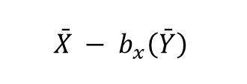
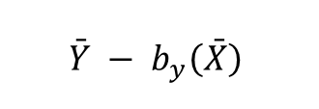
$$x − \bar{x}$$
$${deviations}^{2}$$
$$\sum{\left(\begin{aligned}Squared \\ Deviations\end{aligned}\right)}$$
$$\frac{SS}{n}$$
$$\sqrt{{SD}^{2}}$$
X
Deviations
Squared
Deviations
Sum of Squares
(SS)
Variance
(SD²)
Standard Deviation
(SDₓ)
$$r × \frac{{SD}_{y}}{{SD}_{x}}$$
$$\bar{Y} − b_{y}\left(\bar{X}\right)$$
$$\sum{\left(\begin{aligned}Product of \\ Deviations\end{aligned}\right)}$$
$$\frac{SP}{n}$$
$$\frac{COV}{{SD}_{x} × {SD}_{y}}$$
$$\left(x − \bar{x}\right)\left(y − \bar{y}\right)$$
Product of
Deviations
Sum of Products
(SP)
Covariance
(COV)
Correlation
(r)
Slope
(bᵧ, bₓ)
Intercept
(aᵧ, aₓ)
$$r × \frac{{SD}_{x}}{{SD}_{y}}$$
$$\bar{X} − b_{x}\left(\bar{Y}\right)$$
$$y − \bar{y}$$
$${deviations}^{2}$$
$$\sum{\left(\begin{aligned}Squared \\ Deviations\end{aligned}\right)}$$
$$\frac{SS}{n}$$
$$\sqrt{{SD}^{2}}$$
Y
Deviations
Squared
Deviations
Sum of Squares
(SS)
Variance
(SD²)
Standard Deviation
(SDᵧ)

Slide 19
$$x − \bar{x}$$
$${deviations}^{2}$$
$$\sum{\left(\begin{aligned}Squared \\ Deviations\end{aligned}\right)}$$
$$\frac{SS}{n}$$
$$\sqrt{{SD}^{2}}$$
X
Deviations
Squared
Deviations
Sum of Squares
(SS)
Variance
(SD²)
Standard Deviation
(SDₓ)
$$r × \frac{{SD}_{y}}{{SD}_{x}}$$
$$\bar{Y} − b_{y}\left(\bar{X}\right)$$
$$\sum{\left(\begin{aligned}Product of \\ Deviations\end{aligned}\right)}$$
$$\frac{SP}{n}$$
$$\frac{COV}{{SD}_{x} × {SD}_{y}}$$
$$\left(x − \bar{x}\right)\left(y − \bar{y}\right)$$
Product of
Deviations
Sum of Products
(SP)
Covariance
(COV)
Correlation
(r)
Slope
(bᵧ, bₓ)
Intercept
(aᵧ, aₓ)
$$r × \frac{{SD}_{x}}{{SD}_{y}}$$
$$\bar{X} − b_{x}\left(\bar{Y}\right)$$
$$y − \bar{y}$$
$${deviations}^{2}$$
$$\sum{\left(\begin{aligned}Squared \\ Deviations\end{aligned}\right)}$$
$$\frac{SS}{n}$$
$$\sqrt{{SD}^{2}}$$
Y
Deviations
Squared
Deviations
Sum of Squares
(SS)
Variance
(SD²)
Standard Deviation
(SDᵧ)

Slide 20
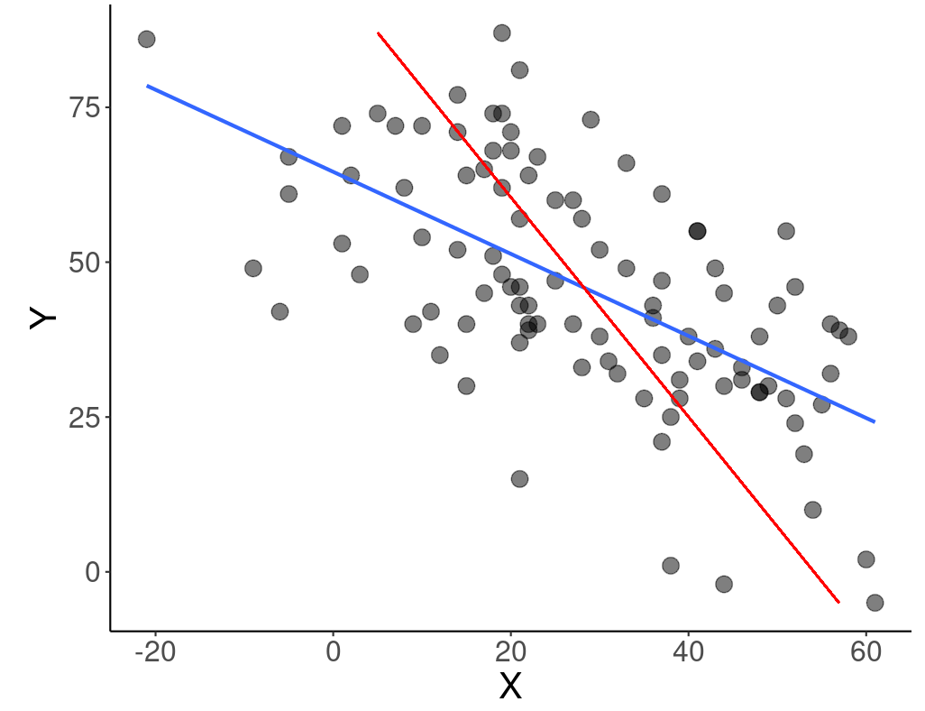
Computing the Regression Line
Steps for Computing Regression
Plot your data!
Determine mean and SD for X and Y
Compute Pearson r
Compute the slopes (b_{y} & b_{x})
Compute the intercepts (a_{y} & a_{x})
Define the regression lines (Y’ & X’)
Plot the regression lines
Compute the standard error

Slide 21
Computing the Regression Line
Hours Exercising (X) | Wellness Score (Y)
2 | 5
6 | 5
7 | 6
4 | 8
1 | 3
3 | 4
6 | 8
11 | 9

Slide 22
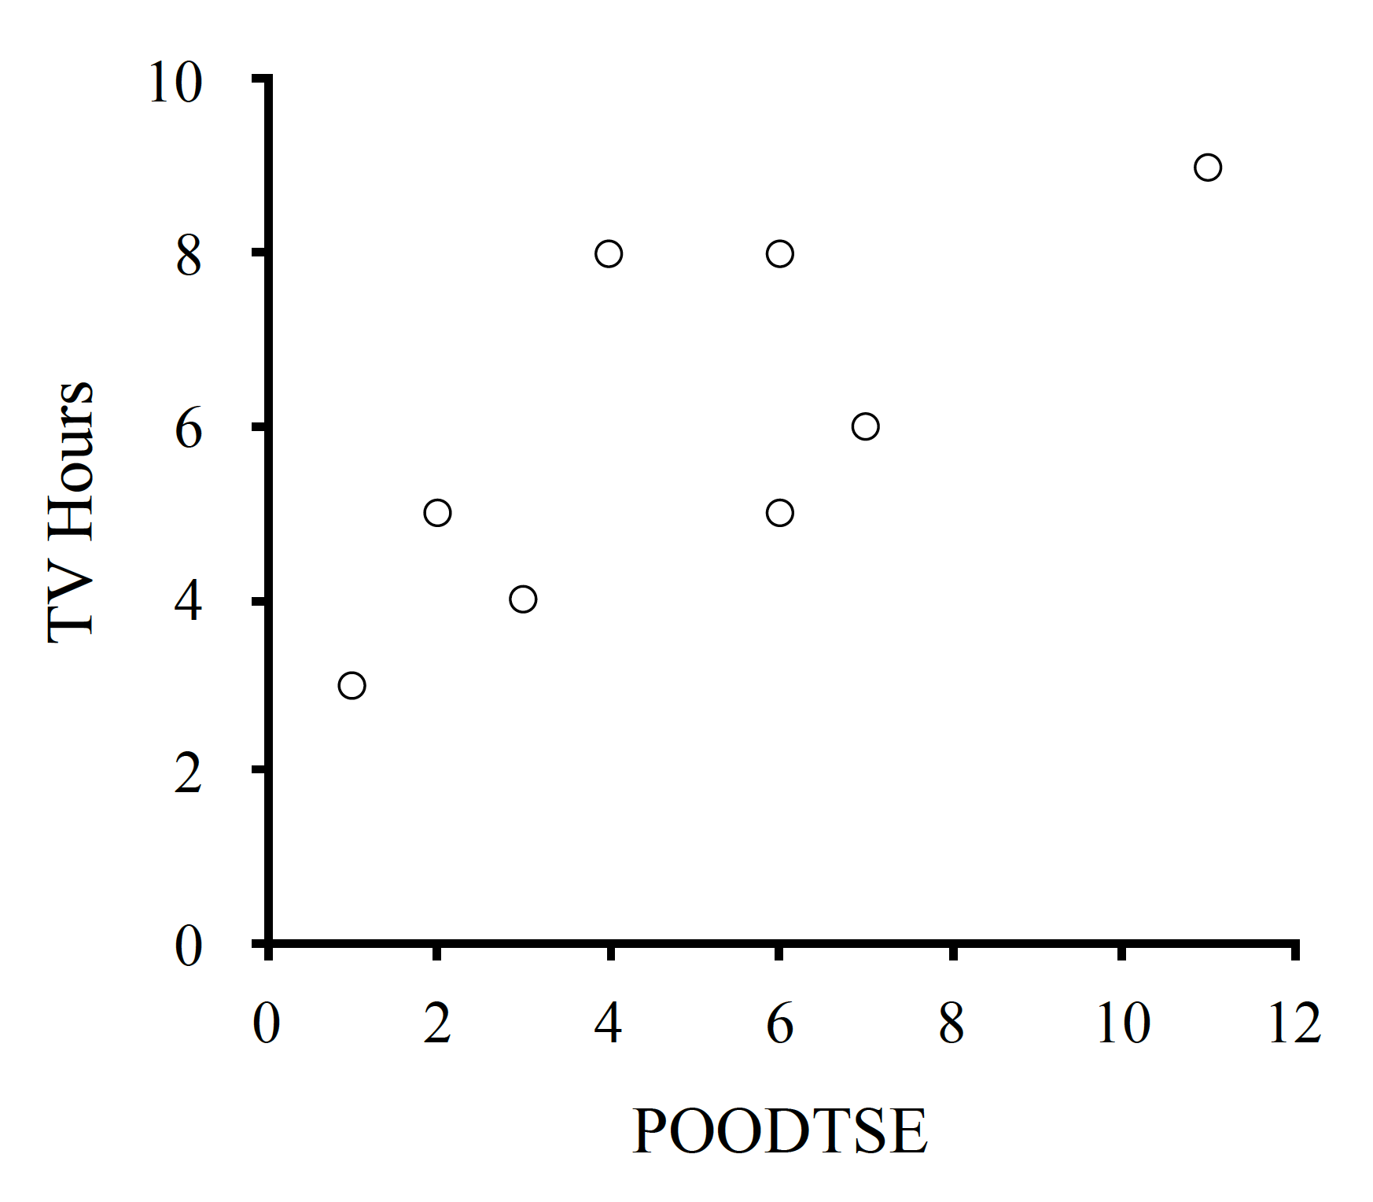
Computing the Regression Line
Steps for Computing Regression
Plot your data!
Determine mean and SD for X and Y
Compute Pearson r
Compute the slopes (b_{y} & b_{x})
Compute the intercepts (a_{y} & a_{x})
Define the regression lines (Y’ & X’)
Plot the regression lines
Compute the standard error
Wellness Score
Hours Exercising

Slide 23
Computing the Regression Line
Steps for Computing Regression
Plot your data!
Determine mean and SD for X and Y
Compute Pearson r
Compute the slopes (b_{y} & b_{x})
Compute the intercepts (a_{y} & a_{x})
Define the regression lines (Y’ & X’)
Plot the regression lines
Compute the standard error
Wellness Score
Hours Exercising

Slide 24
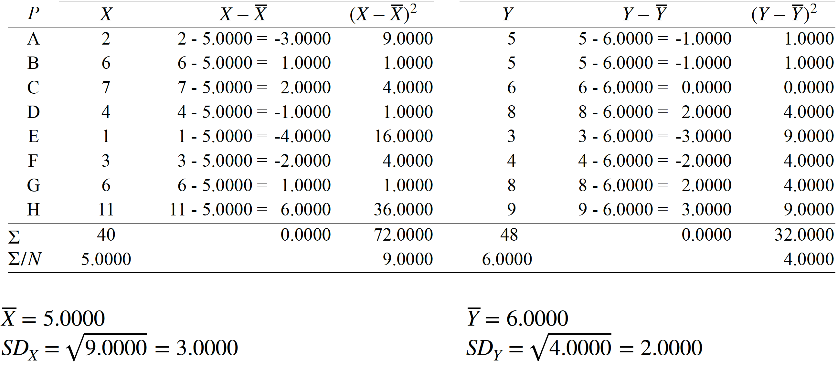
Computing the Regression Line
x̅ = 5.0000, Ȳ = 6.0000, SD_{x} = 3.0000, SD_{y} = 2.0000

Slide 25
Computing the Regression Line
Steps for Computing Regression
Plot your data!
Determine mean and SD for X and Y
Compute Pearson r
Compute the slopes (b_{y} & b_{x})
Compute the intercepts (a_{y} & a_{x})
Define the regression lines (Y’ & X’)
Plot the regression lines
Compute the standard error
Wellness Score
Hours Exercising
X̄ = 5.0000, Ȳ = 6.0000, SD_{x} = 3.0000, SD_{y} = 2.0000

Slide 26
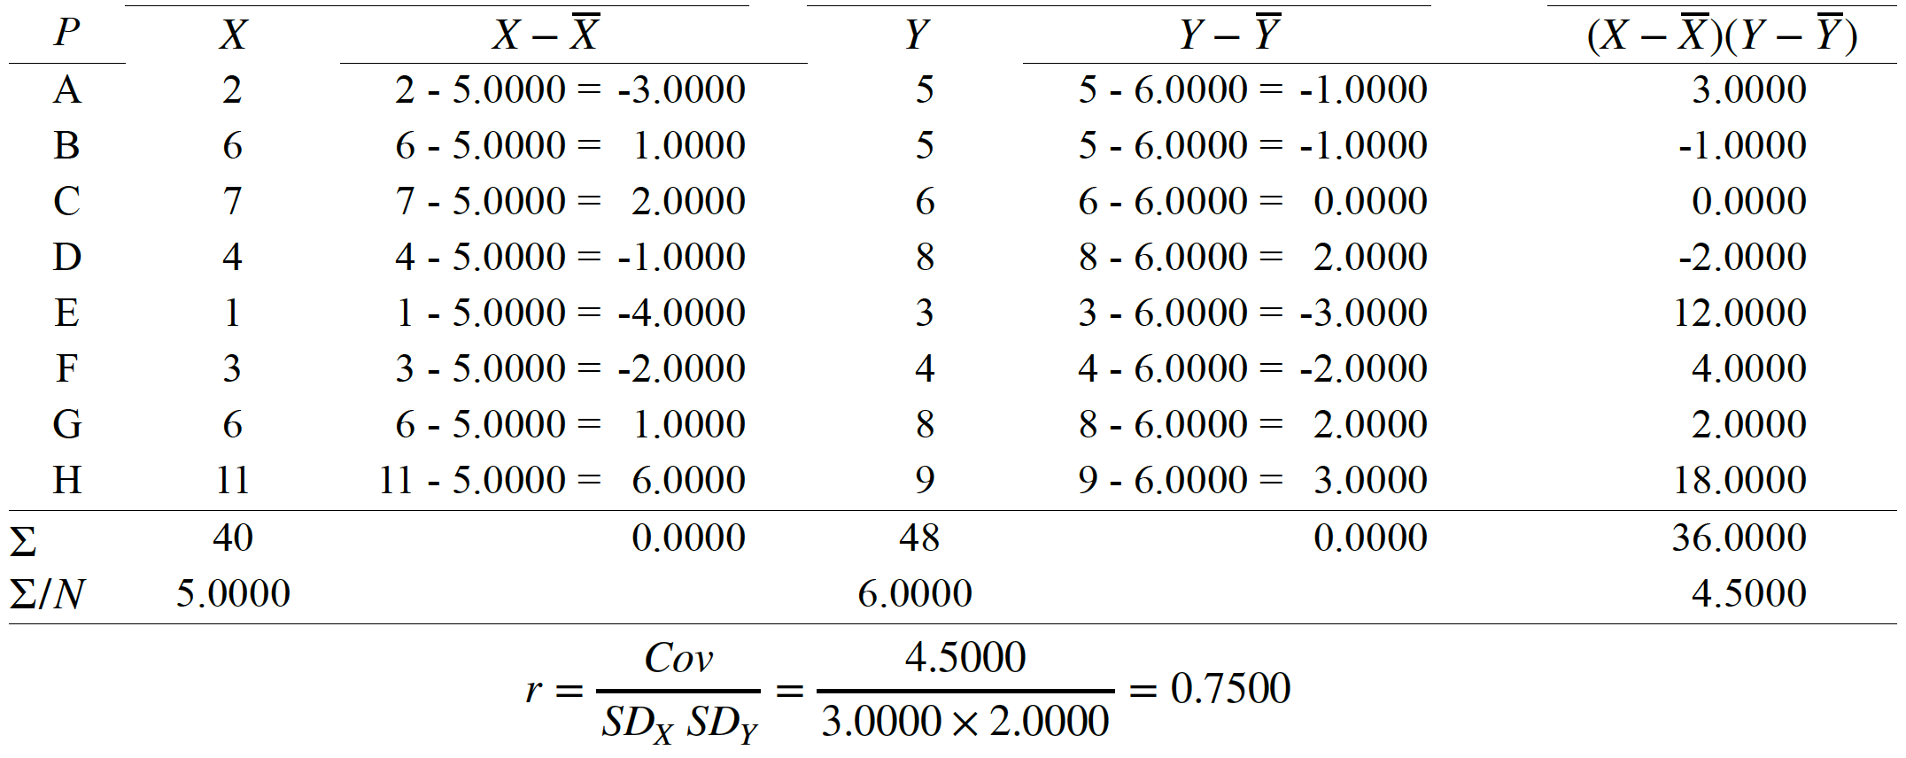
Computing the Regression Line
X̄ = 5.0000, Ȳ = 6.0000, SD_{x} = 3.0000, SD_{y} = 2.0000, r = 0.7500

Slide 27
Computing the Regression Line
Steps for Computing Regression
Plot your data!
Determine mean and SD for X and Y
Compute Pearson r
Compute the slopes (b_{y} & b_{x})
Compute the intercepts (a_{y} & a_{x})
Define the regression lines (Y’ & X’)
Plot the regression lines
Compute the standard error
Wellness Score
Hours Exercising
X̄ = 5.0000, Ȳ = 6.0000, SD_{x} = 3.0000, SD_{y} = 2.0000, r = 0.7500

Slide 28
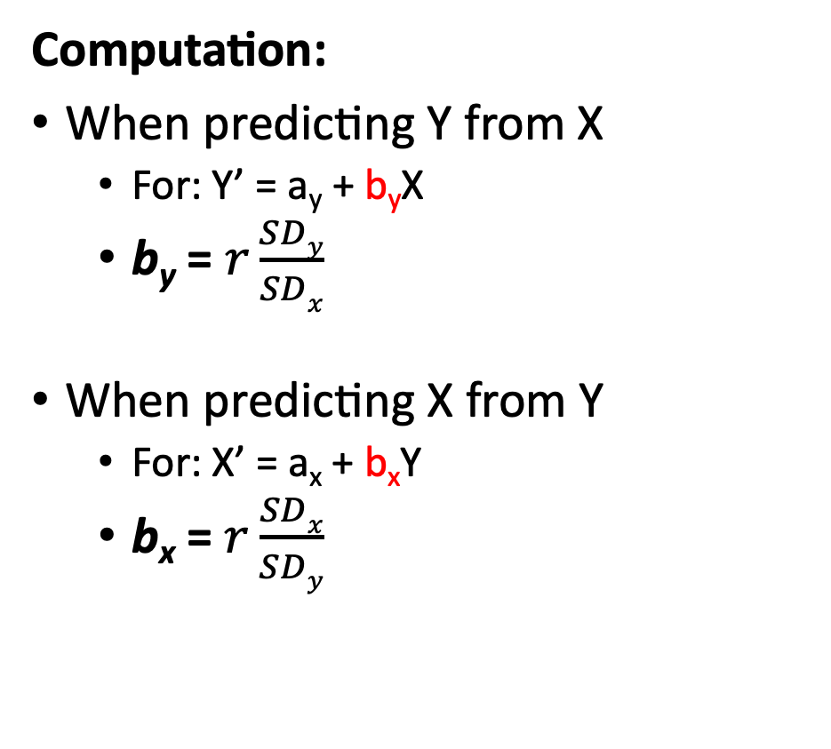
Slope (b)
Computation:
When predicting Y from X
For: Y’ = a_{y} + b_{y}X
b_{y} = $r\frac{SDy}{SDx}$
When predicting X from Y
For: X’ = a_{x} + b_{x}Y
b_{x} = $r\frac{SDx}{SDy}$
Wellness Score
Hours Exercising
X̄ = 5.0000, Ȳ = 6.0000, SD_{x} = 3.0000, SD_{y} = 2.0000, r = 0.7500

Slide 29
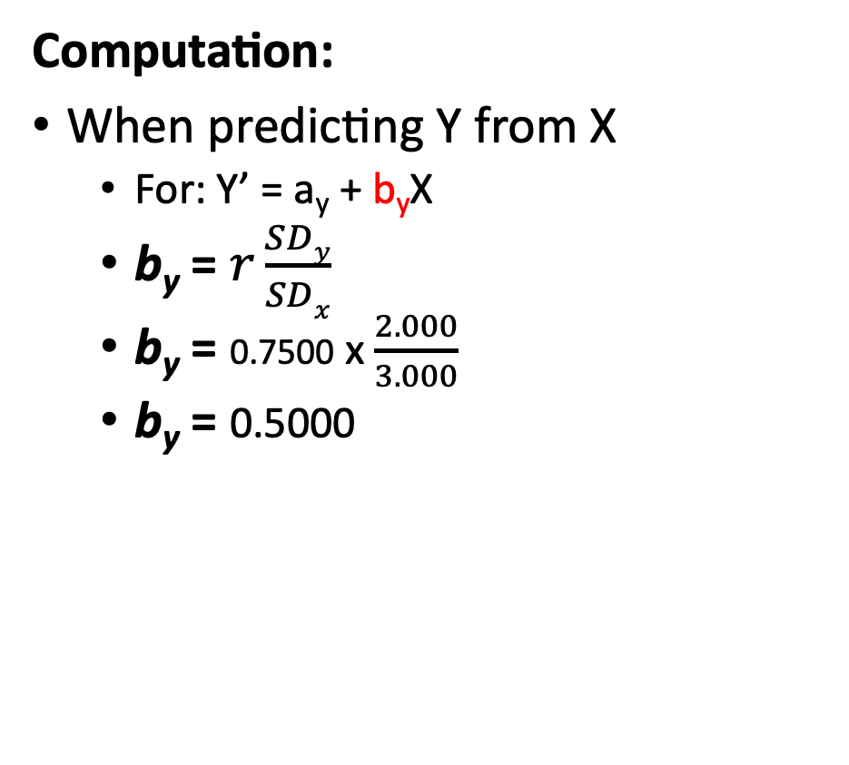
Slope (b)
Computation:
When predicting Y from X
For: Y’ = a_{y} + b_{y}X
b_{y} = $r\frac{SDy}{SDx}$
b_{y} = 0.7500 x $\frac{2.000}{3.000}$
b_{y} = 0.5000
Wellness Score
Hours Exercising
X̄ = 5.0000, Ȳ = 6.0000, SD_{x} = 3.0000, SD_{y} = 2.0000, r = 0.7500, b_{y} = 0.5000

Slide 30
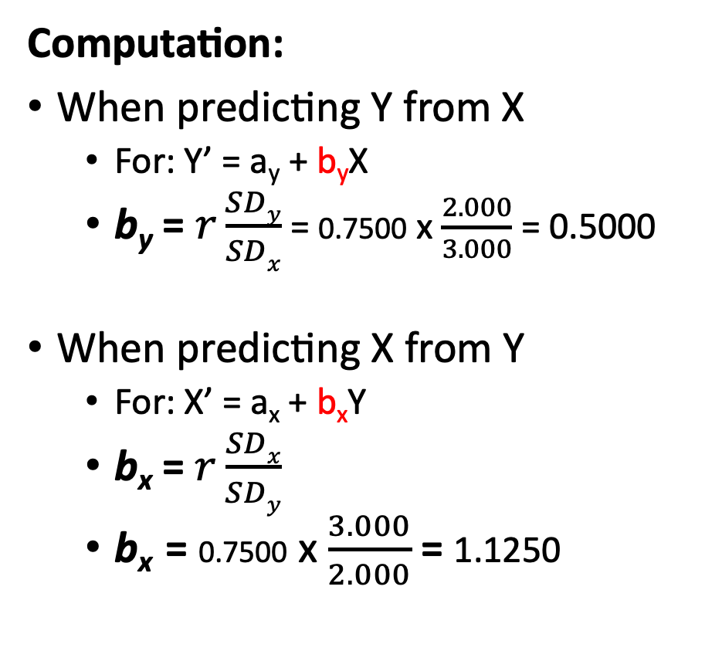
Slope (b)
Computation:
When predicting Y from X
For: Y’ = a_{y} + b_{y}X
b_{y} = $r\frac{SDy}{SDx}$ = 0.7500 x $\frac{2.000}{3.000}$ = 0.5000
When predicting X from Y
For: X’ = a_{x} + b_{x}Y
b_{x} = $r\frac{SDx}{SDy}$
b_{x} = 0.7500 x $\frac{3.000}{2.000}$= 1.1250
X̄ = 5.0000, Ȳ = 6.0000, SD_{x} = 3.0000, SD_{y} = 2.0000, r = 0.7500, b_{y} = 0.5000, b_{x} = 1.1250

Slide 31
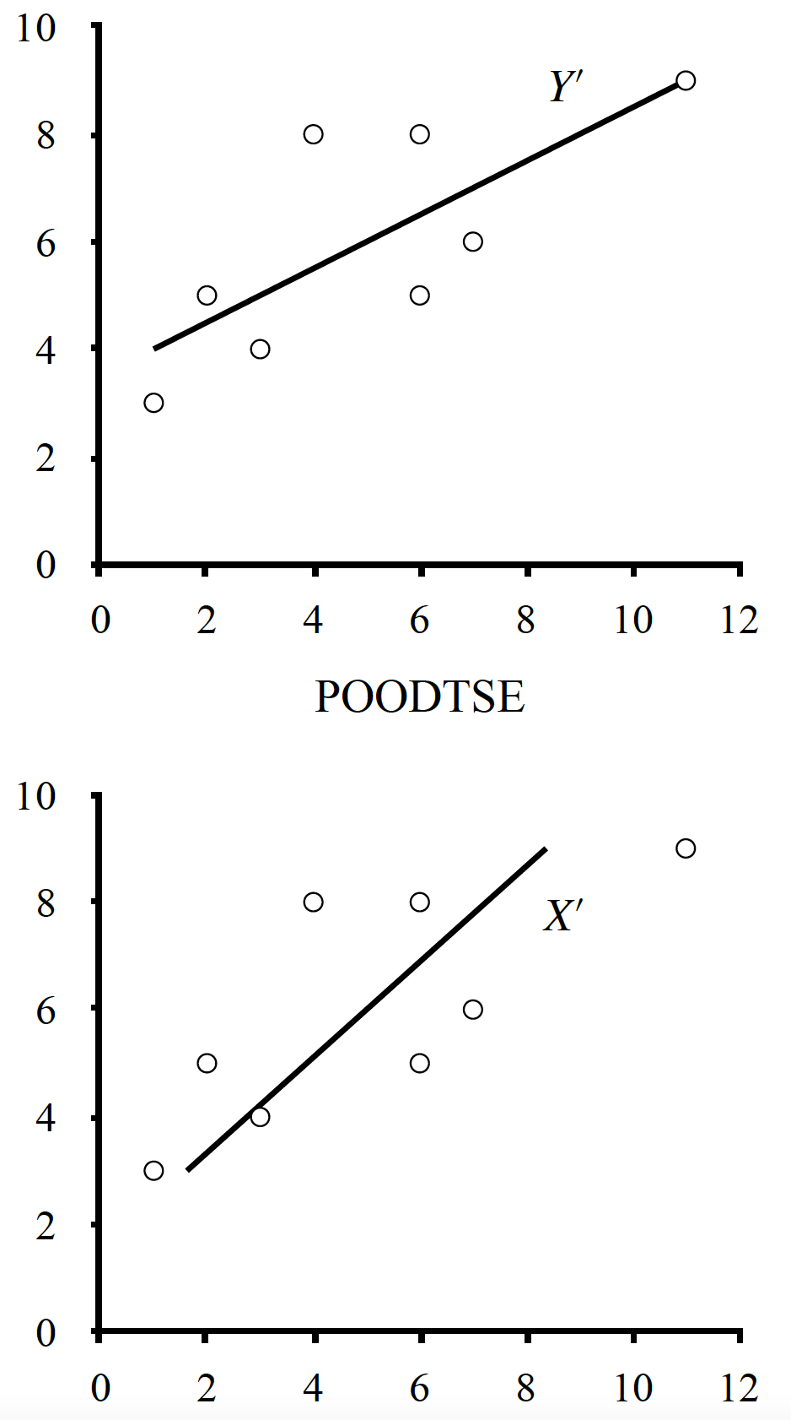
Computing the Regression Line
Wellness Score
Steps for Computing Regression
Plot your data!
Determine mean and SD for X and Y
Compute Pearson r
Compute the slopes (b_{y} & b_{x})
Compute the intercepts (a_{y} & a_{x})
Define the regression lines (Y’ & X’)
Plot the regression lines
Compute the standard error
Hours Exercising
Wellness Score
Hours Exercising
X̄ = 5.0000, Ȳ = 6.0000, SD_{x} = 3.0000, SD_{y} = 2.0000, r = 0.7500, b_{y} = 0.5000, b_{x} = 1.1250

Slide 32
Intercept (a)
Wellness Score
Computation:
When predicting Y from X
For: Y’ = a_{y} + b_{y}X
a_{y} = y̅ - b_{y}(x̅)
This is where the regression line hits the Y-axis
When predicting X from Y
For: X’ = a_{x} + b_{x}Y
a_{x} = x̅- b_{x}(y̅)
This is where the regression line hits the X-axis
Hours Exercising
Wellness Score
Hours Exercising
X̄ = 5.0000, Ȳ = 6.0000, SD_{x} = 3.0000, SD_{y} = 2.0000, r = 0.7500, b_{y} = 0.5000, b_{x} = 1.1250

Slide 33
Intercept (a)
Wellness Score
Computation:
When predicting Y from X
For: Y’ = a_{y} + b_{y}X
a_{y} = y̅ - b_{y}(x̅)
a_{y} = 6.0000 – 0.5000(5.0000)
a_{y} = 3.5000
Hours Exercising
Wellness Score
Hours Exercising
X̄ = 5.0000, Ȳ = 6.0000, SD_{x} = 3.0000, SD_{y} = 2.0000, r = 0.7500, b_{y} = 0.5000, b_{x} = 1.1250, a_{y} = 3.5000

Slide 34
Intercept (a)
Wellness Score
Computation:
When predicting Y from X
For: Y’ = a_{y} + b_{y}X
a_{y} = y̅ - b_{y}(x̅) = 6.0000 – 0.5000(5.0000) = 3.5000
When predicting X from Y
For: X’ = a_{x} + b_{x}Y
a_{x} = x̅ - b_{x}(y̅)
a_{x} = 5.0000 – 1.1250(6.0000)
a_{x} = -1.7500
Hours Exercising
Wellness Score
Hours Exercising
X̄ = 5.0000, Ȳ = 6.0000, SD_{x} = 3.0000, SD_{y} = 2.0000, r = 0.7500, b_{y} = 0.5000, b_{x} = 1.1250, a_{y} = 3.5000, a_{x} = -1.7500

Slide 35
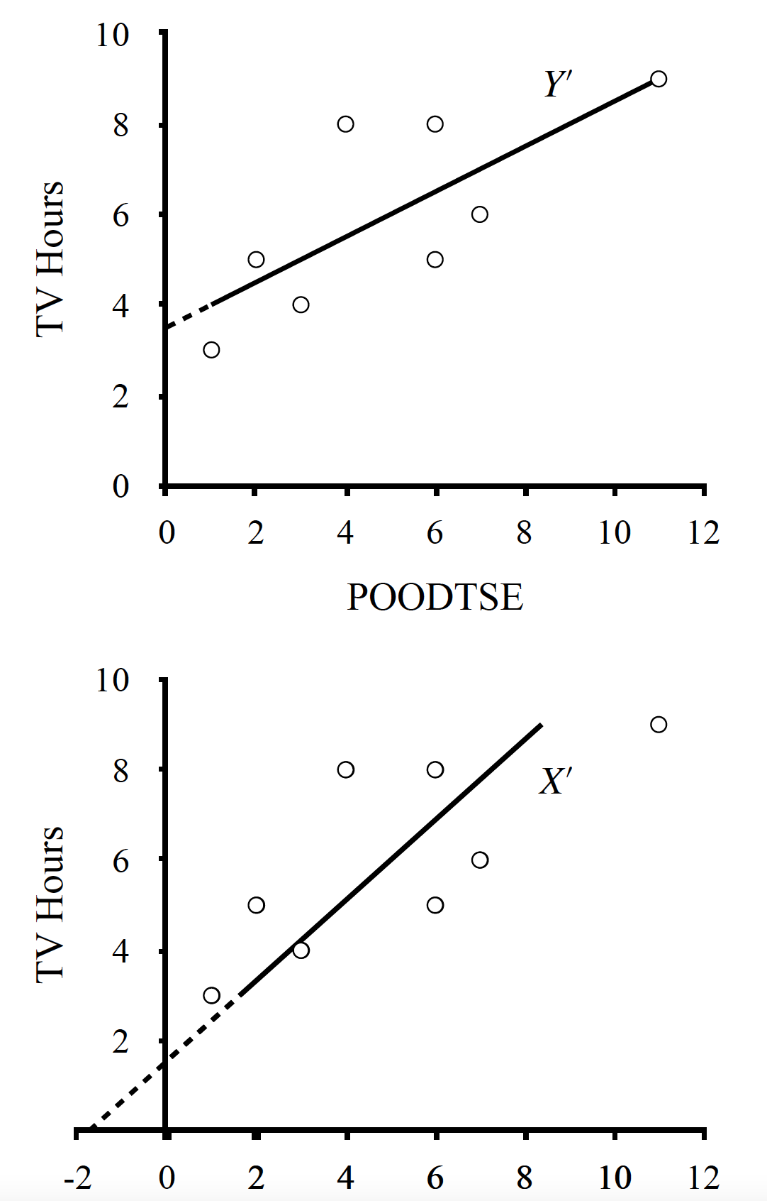
Intercept (a)
Wellness Score
Computation:
When predicting Y from X
For: Y’ = a_{y} + b_{y}X
a_{y} = y̅ - b_{y}(x̅) = 6.0000 – 0.5000(5.0000) = 3.5000
When predicting X from Y
For: X’ = a_{x} + b_{x}Y
a_{x} = x̅ - b_{x}(y̅) = 5.0000 – 1.1250(6.0000) = -1.7500
Hours Exercising
Wellness Score
X̄ = 5.0000, Ȳ = 6.0000, SD_{x} = 3.0000, SD_{y} = 2.0000, r = 0.7500, b_{y} = 0.5000, b_{x} = 1.1250, a_{y} = 3.5000, a_{x} = -1.7500

Slide 36
Computing the Regression Line
Wellness Score
Steps for Computing Regression
Plot your data!
Determine mean and SD for X and Y
Compute Pearson r
Compute the slopes (b_{y} & b_{x})
Compute the intercepts (a_{y} & a_{x})
Define the regression lines (Y’ & X’)
Plot the regression lines
Compute the standard error
Hours Exercising
Wellness Score
Hours Exercising
X̄ = 5.0000, Ȳ = 6.0000, SD_{x} = 3.0000, SD_{y} = 2.0000, r = 0.7500, b_{y} = 0.5000, b_{x} = 1.1250, a_{y} = 3.5000, a_{x} = -1.7500

Slide 37
Defining the Regression Line
Wellness Score
Defining the regression line is to write out the equation with the computed coefficients (slope and intercept)
Defining Y’
Y’ = a_{y} + b_{y}X
a_{y} & b_{y} are coefficients
Y’ = 3.50 + 0.50(X)
Using it, X = 4: Y’ = 3.5000 + 0.5000(4) = 5.50
Hours Exercising
This is the defined regression line!
Wellness Score
Hours Exercising
X̄ = 5.0000, Ȳ = 6.0000, SD_{x} = 3.0000, SD_{y} = 2.0000, r = 0.7500, b_{y} = 0.5000, b_{x} = 1.1250, a_{y} = 3.5000, a_{x} = -1.7500

Slide 38
Defining the Regression Line
Wellness Score
Defining the regression line is to write out the equation with the computed coefficients (slope and intercept)
Defining X’
X’ = a_{x} + b_{x}Y
a_{x} & b_{x} are coefficients
X’ = -1.75 + 1.13(Y)
Using it, Y = 8: X’ = -1.7500 + 1.1250(8) = 7.25
Hours Exercising
This is the defined regression line!
Wellness Score
Hours Exercising
X̄ = 5.0000, Ȳ = 6.0000, SD_{x} = 3.0000, SD_{y} = 2.0000, r = 0.7500, b_{y} = 0.5000, b_{x} = 1.1250, a_{y} = 3.5000, a_{x} = -1.7500

Slide 39
Computing the Regression Line
Wellness Score
Steps for Computing Regression
Plot your data!
Determine mean and SD for X and Y
Compute Pearson r
Compute the slopes (b_{y} & b_{x})
Compute the intercepts (a_{y} & a_{x})
Define the regression lines (Y’ & X’)
Plot the regression lines
Compute the standard error
Hours Exercising
Wellness Score
Hours Exercising
X̄ = 5.0000, Ȳ = 6.0000, SD_{x} = 3.0000, SD_{y} = 2.0000, r = 0.7500, b_{y} = 0.5000, b_{x} = 1.1250, a_{y} = 3.5000, a_{x} = -1.7500

Slide 40
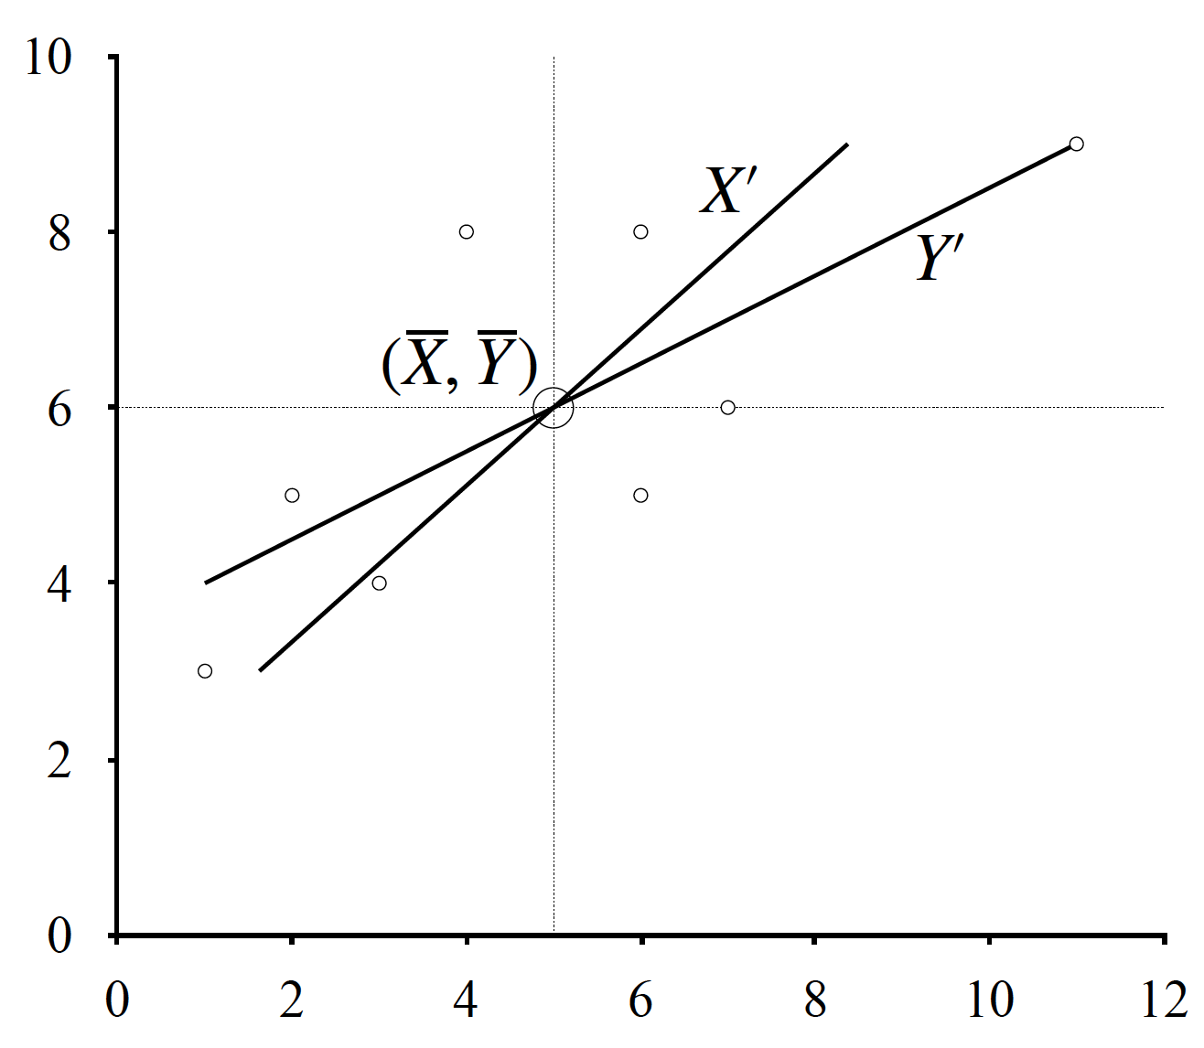
Plotting the Regression Line
Plotting a regression line means we need to know different points on that regression line
We already know the intercepts
The regression lines also converge where the mean of X and Y meet
We can also calculate any point on the regression lines using the equation just defined
Y’ = 3.50 + 0.50(X)
For X = 4: Y’ = 3.5000 + 0.5000(4) = 5.50
X̄ = 5.0000, Ȳ = 6.0000, SD_{x} = 3.0000, SD_{y} = 2.0000, r = 0.7500, b_{y} = 0.5000, b_{x} = 1.1250, a_{y} = 3.5000, a_{x} = -1.7500

Slide 41
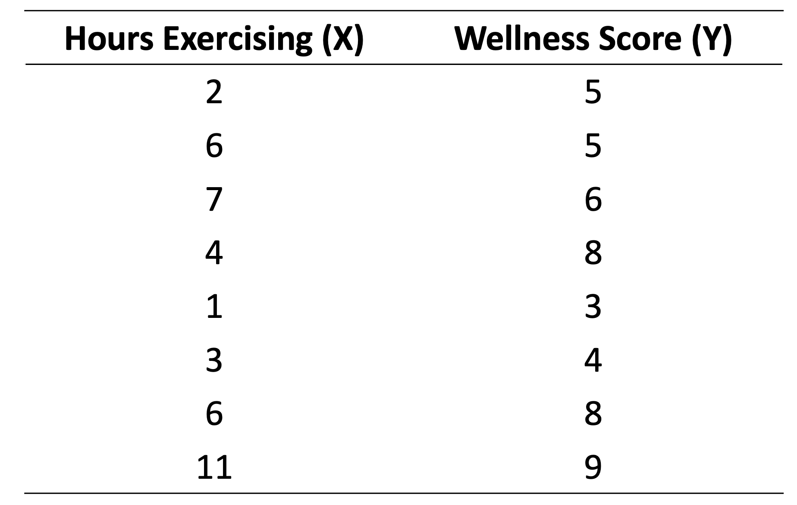
Plotting the Regression Line
The start and end of each regression line can be computed using the lowest and highest score (of the other variable)
Y’ = 3.50 + 0.50(X)
Lowest: Y’ = 3.50 + 0.50(1) = 4.0000
Highest: Y’ = 3.50 + 0.50(11) = 9.0000
Wellness Score
Hours Exercising
X̄ = 5.0000, Ȳ = 6.0000, SD_{x} = 3.0000, SD_{y} = 2.0000, r = 0.7500, b_{y} = 0.5000, b_{x} = 1.1250, a_{y} = 3.5000, a_{x} = -1.7500

Slide 42
Plotting the Regression Line
The start and end of each regression line can be computed using the lowest and highest score (of the other variable)
X’ = -1.75 + 1.13(Y)
Lowest: X’ = -1.75 + 1.13(3) = 1.6400
Highest: X’ = -1.75 + 1.13(9) = 8.4200
Wellness Score
Hours Exercising
X̄ = 5.0000, Ȳ = 6.0000, SD_{x} = 3.0000, SD_{y} = 2.0000, r = 0.7500, b_{y} = 0.5000, b_{x} = 1.1250, a_{y} = 3.5000, a_{x} = -1.7500

Slide 43
Plotting the Regression Line
The start and end of each regression line can be computed using the lowest and highest score (of the other variable)
Y’ = 3.50 + 0.50(X)
Lowest: Y’ = 3.50 + 0.50(1) = 4.0000
Highest: Y’ = 3.50 + 0.50(11) = 9.0000
X’ = -1.75 + 1.13(Y)
Lowest: X’ = -1.75 + 1.13(3) = 1.6400
Highest: X’ = -1.75 + 1.13(9) = 8.4200
Wellness Score
Hours Exercising
X̄ = 5.0000, Ȳ = 6.0000, SD_{x} = 3.0000, SD_{y} = 2.0000, r = 0.7500, b_{y} = 0.5000, b_{x} = 1.1250, a_{y} = 3.5000, a_{x} = -1.7500

Slide 44
Plotting the Regression Line
Important note: The regression lines DO NOT go past the data
Because we can only predict scores within our observed data
Interpolation, not extrapolation
Interpolation: Estimating unknown values within known data points
Extrapolation: Estimating unknown values outside of known data points
Wellness Score
Hours Exercising

Slide 45
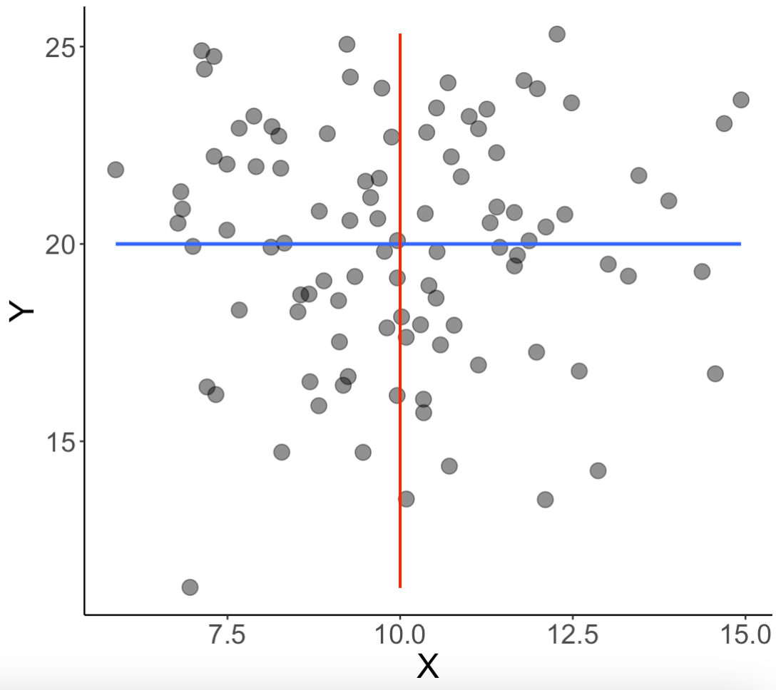
Regression and Correlation
If r = 0 then slopes (b_{y} & b_{x}) = 0
Regression line is parallel to the axes
The regression lines then simply becomes the mean of Y and X
a_{y} = y̅, a_{x} = x̅
Y’ = a_{y} + b_{y}X
Y’ = a_{y} + 0X
Y’ = a_{y} = y̅
Y’ = y̅

Slide 46
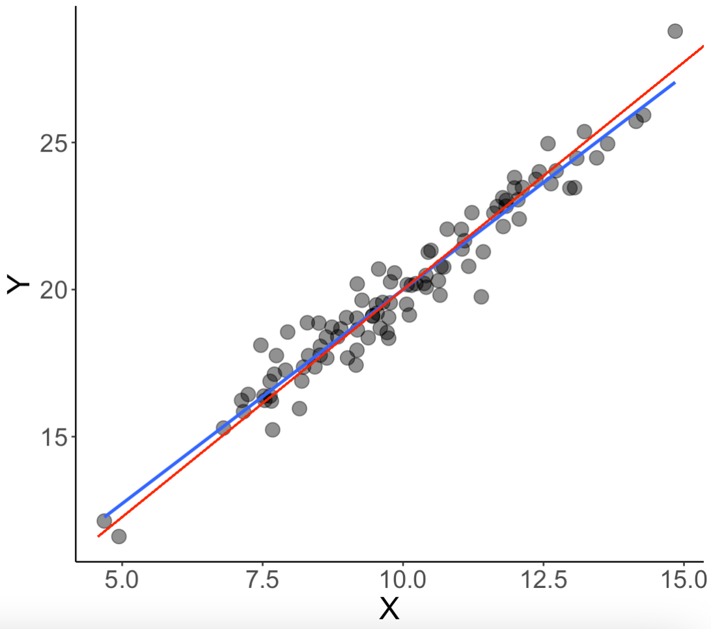
Regression and Correlation
As r increases, the slope increases
The two regression lines converge towards becoming the same
At r = ± 1, they completely overlap

Slide 47
Computing the Regression Line
Wellness Score
Steps for Computing Regression
Plot your data!
Determine mean and SD for X and Y
Compute Pearson r
Compute the slopes (b_{y} & b_{x})
Compute the intercepts (a_{y} & a_{x})
Define the regression lines (Y’ & X’)
Plot the regression lines
Compute the standard error
Hours Exercising
Wellness Score
Hours Exercising
X̄ = 5.0000, Ȳ = 6.0000, SD_{x} = 3.0000, SD_{y} = 2.0000, r = 0.7500, b_{y} = 0.5000, b_{x} = 1.1250, a_{y} = 3.5000, a_{x} = -1.7500

Slide 48
Lecture Outline
Regression Conceptually
Computing Regression Lines
Standard Error of the Regression Line
Explained Variability
Formal Report

Slide 49


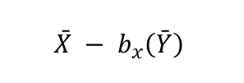

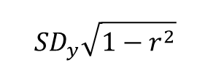

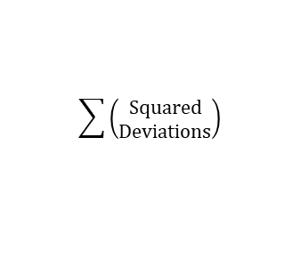
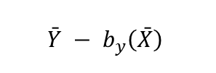
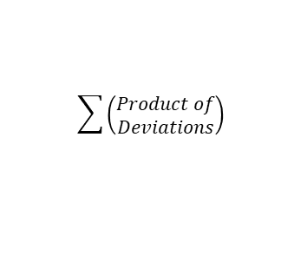
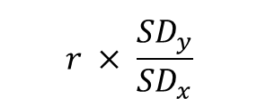

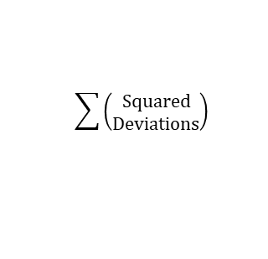


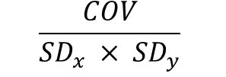
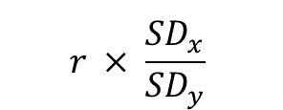



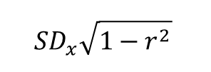
$$x − \bar{x}$$
$${deviations}^{2}$$
$$\sum{\left(\begin{aligned}Squared \\ Deviations\end{aligned}\right)}$$
$$\frac{SS}{n}$$
$$\sqrt{{SD}^{2}}$$
X
Deviations
Squared
Deviations
Sum of Squares
(SS)
Variance
(SD²)
Standard Deviation
(SDₓ)
$$r × \frac{{SD}_{y}}{{SD}_{x}}$$
$$\bar{Y} − b_{y}\left(\bar{X}\right)$$
$${SD}_{y}\sqrt{1−r^{2}}$$
$$\sum{\left(\begin{aligned}Product of \\ Deviations\end{aligned}\right)}$$
$$\frac{SP}{n}$$
$$\frac{COV}{{SD}_{x} × {SD}_{y}}$$
$$\left(x − \bar{x}\right)\left(y − \bar{y}\right)$$
Product of
Deviations
Sum of Products
(SP)
Covariance
(COV)
Correlation
(r)
Slope
(bᵧ, bₓ)
Intercept
(aᵧ, aₓ)
Standard Error of Regression
(SD_{y’}, SD_{x’})
$$r × \frac{{SD}_{x}}{{SD}_{y}}$$
$$\bar{X} − b_{x}\left(\bar{Y}\right)$$
$${SD}_{x}\sqrt{1−r^{2}}$$
$$y − \bar{y}$$
$${deviations}^{2}$$
$$\sum{\left(\begin{aligned}Squared \\ Deviations\end{aligned}\right)}$$
$$\frac{SS}{n}$$
$$\sqrt{{SD}^{2}}$$
Y
Deviations
Squared
Deviations
Sum of Squares
(SS)
Variance
(SD²)
Standard Deviation
(SDᵧ)

Slide 50
Standard Error of Regression (SD_{Y’ or} SD_{Y-Y’} )
Residuals: The deviation each score is from the predicted value of the regression line
Y-Y’
Wellness Score
Hours Exercising

Slide 51
Standard Error of Regression (SD_{Y’ or} SD_{Y-Y’} )
Residuals: The deviation each score is from the predicted value of the regression line
X-X’
Wellness Score
Hours Exercising

Slide 52
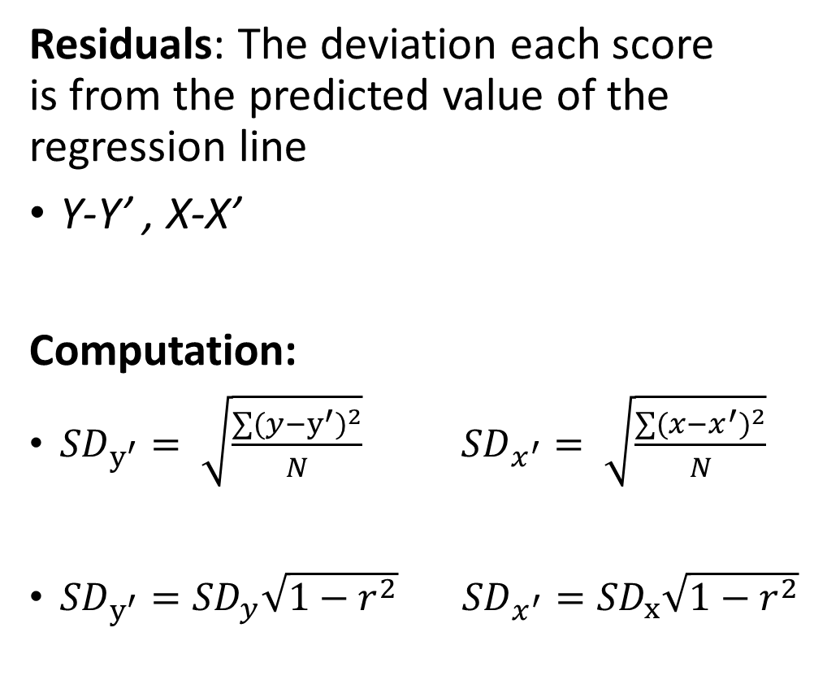
Standard Error of Regression (SD_{Y’ or} SD_{Y-Y’} )
Residuals: The deviation each score is from the predicted value of the regression line
Y-Y’ , X-X’
Computation:
${SD}_{y^{′}}= \sqrt{\frac{{∑(y−y^{′})}^{2}}{N}}$ ${SD}_{x^{′}}= \sqrt{\frac{{∑(x−x^{′})}^{2}}{N}}$
${SD}_{y^{′}}={SD}_{y}\sqrt{1−r^{2}}$ ${SD}_{x^{′}}={SD}_{x}\sqrt{1−r^{2}}$
Wellness Score
OR
Hours Exercising

Slide 53

Standard Error of Regression (SD_{Y’ or} SD_{Y-Y’} )
SD_{Y’} =${ SD}_{y}\sqrt{1−r^{2}}=$
$$2.0000\sqrt{1−{0.7500}^{2}}=2.0000\sqrt{1−0.5625}$$
$$=2.0000\sqrt{0.4375}=2.0000∗0.6614=1.3229$$
SD_{X’} =${ SD}_{x}\sqrt{1−r^{2}}=$
$$3.0000\sqrt{1−{0.7500}^{2}}=3.0000\sqrt{1−0.5625}$$
$$=3.0000\sqrt{0.4375}=3.0000∗0.6614=1.9843$$
SD_{x} = 3.0000, SD_{y} = 2.0000, r = 0.7500

Slide 54
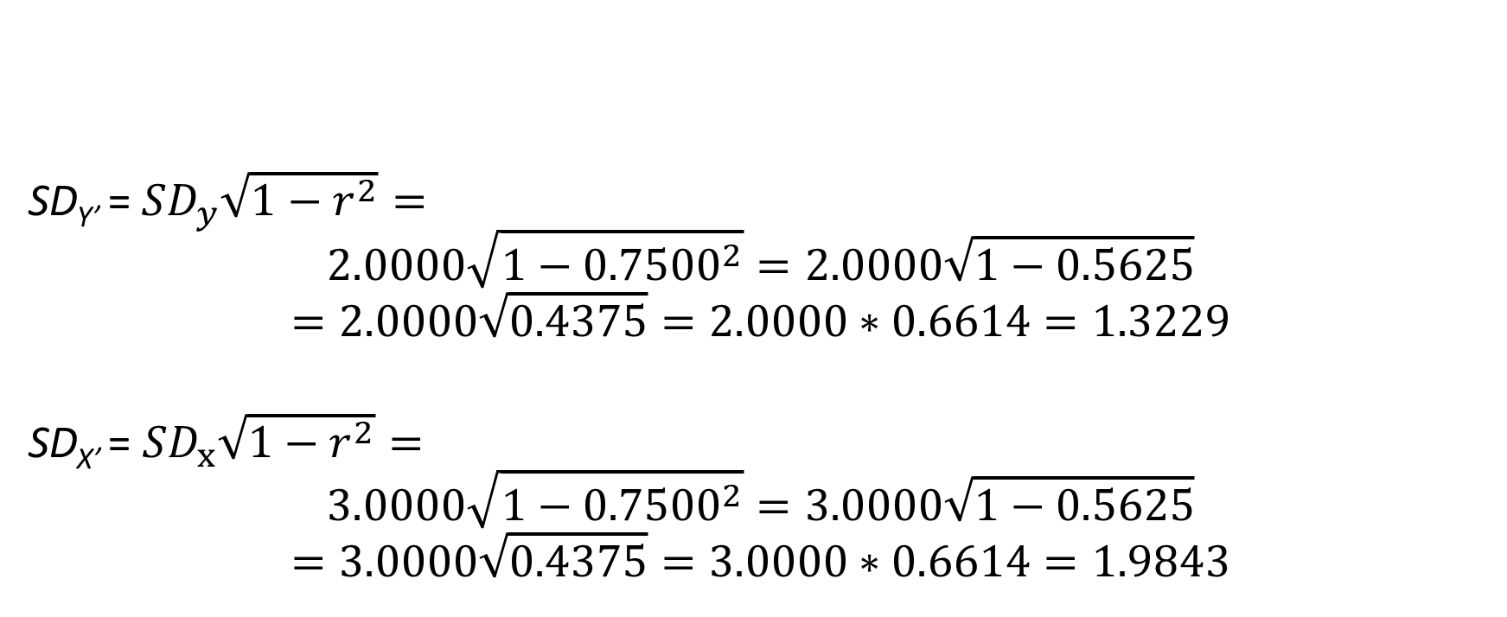
Standard Error of Regression (SD_{Y’ or} SD_{Y-Y’} )
SD_{Y’} =${ SD}_{y}\sqrt{1−r^{2}}=$
$$2.0000\sqrt{1−{0.7500}^{2}}=2.0000\sqrt{1−0.5625}$$
$$=2.0000\sqrt{0.4375}=2.0000∗0.6614=1.3229$$
SD_{X’} = ${SD}_{x}\sqrt{1−r^{2}}=$
$$3.0000\sqrt{1−{0.7500}^{2}}=3.0000\sqrt{1−0.5625}$$
$$=3.0000\sqrt{0.4375}=3.0000∗0.6614=1.9843$$
SD_{x} = 3.0000, SD_{y} = 2.0000, r = 0.7500

Slide 55
$$x − \bar{x}$$
$${deviations}^{2}$$
$$\sum{\left(\begin{aligned}Squared \\ Deviations\end{aligned}\right)}$$
$$\frac{SS}{n}$$
$$\sqrt{{SD}^{2}}$$
X
Deviations
Squared
Deviations
Sum of Squares
(SS)
Variance
(SD²)
Standard Deviation
(SDₓ)
$$r × \frac{{SD}_{y}}{{SD}_{x}}$$
$$\bar{Y} − b_{y}\left(\bar{X}\right)$$
$${SD}_{y}\sqrt{1−r^{2}}$$
$$\sum{\left(\begin{aligned}Product of \\ Deviations\end{aligned}\right)}$$
$$\frac{SP}{n}$$
$$\frac{COV}{{SD}_{x} × {SD}_{y}}$$
$$\left(x − \bar{x}\right)\left(y − \bar{y}\right)$$
Product of
Deviations
Sum of Products
(SP)
Covariance
(COV)
Correlation
(r)
Slope
(bᵧ, bₓ)
Intercept
(aᵧ, aₓ)
Standard Error of Regression
(SD_{y’}, SD_{x’})
$$r × \frac{{SD}_{x}}{{SD}_{y}}$$
$$\bar{X} − b_{x}\left(\bar{Y}\right)$$
$${SD}_{x}\sqrt{1−r^{2}}$$
$$y − \bar{y}$$
$${deviations}^{2}$$
$$\sum{\left(\begin{aligned}Squared \\ Deviations\end{aligned}\right)}$$
$$\frac{SS}{n}$$
$$\sqrt{{SD}^{2}}$$
Y
Deviations
Squared
Deviations
Sum of Squares
(SS)
Variance
(SD²)
Standard Deviation
(SDᵧ)

Slide 56
Lecture Outline
Regression Conceptually
Computing Regression Lines
Standard Error of the Regression Line
Explained Variability
Formal Report

Slide 57
Variability Explained
Total Variability | Explained Variability | Unexplained Variability
X_{o} | X_{t} | X_{e}
(Y-Ȳ) | (Y’-Ȳ) | (Y-Y’)

Slide 58
Variability Explained
Total Variability | Explained Variability | Unexplained Variability
X_{o} | X_{t} | X_{e}
Y-Ȳ | Y’-Ȳ | Y-Y’

Slide 59
Variability Explained
Total Variability: Y-Ȳ
Explained Variability: Y’-Ȳ
Unexplained Variability: Y-Y’
Y’
Wellness Score
Ȳ
Hours Exercising

Slide 60
Variability Explained
Total Variability: Y-Ȳ
Explained Variability: Y’-Ȳ
Unexplained Variability: Y-Y’
Y’
Wellness Score
Ȳ
Hours Exercising

Slide 61
Variability Explained
Total Variability: Y-Ȳ
Explained Variability: Y’-Ȳ
Unexplained Variability: Y-Y’
Y’
Wellness Score
Ȳ
Hours Exercising

Slide 62
Variability Explained
Total Variability | Explained Variability | Unexplained Variability
Y-Ȳ | Y’-Ȳ | Y-Y’
Y’
Y’
Y’
Ȳ
Ȳ
Ȳ

Slide 63
Variability Explained
Explained Variability in Regression: How much error is reduced because we are taking into account the correlation
We are not asking if a regression is good or not but instead asking if it’s better than the mean
Y’
Wellness Score
Ȳ
Hours Exercising

Slide 64
Variability Explained
Explained Variability in Regression: How much error is reduced because we are taking into account the correlation.
We are not asking if a regression is good or not but instead asking if it’s better than the mean
It’s better if the scores are closer to the regression line than to the mean
Y’
Wellness Score
Ȳ
Hours Exercising

Slide 65
Variability Explained
Explained Variability in Regression: How much error is reduced because we are taking into account the correlation
When r = 0, SD_{Y} = SD_{Y’}
Everything is unexplained variability
Different scores of X predict same Y-values (i.e., the mean of Y)
When r = ± 1, SD_{Y’} = 0
Everything is explained variability
Prediction is more accurate because we are accounting for two sources
Y’
Wellness Score
Ȳ
Hours Exercising

Slide 66
Variability Explained
Total Variability | Explained Variability | Unexplained Variability
Y-Ȳ | Y’-Ȳ | Y-Y’

Slide 67
Variability Explained
Total Variability | Explained Variability | Unexplained Variability
1 | r² | 1-r²
1 | 0.7500² | 1-0.7500²
1 (100%) | 0.5625 (56%) | 0.4375 (44%)
X̄ = 5.0000, Ȳ = 6.0000, SD_{x} = 3.0000, SD_{y} = 2.0000, r = 0.7500, b_{y} = 0.5000, b_{x} = 1.1250, a_{y} = 3.5000, a_{x} = -1.7500

Slide 68
Variability Explained
Total Variability | Explained Variability | Unexplained Variability
1 | r² | 1-r²
1 | 0.7500² | 1-0.7500²
1 (100%) | 0.5625 (56%) | 0.4375 (44%)
X̄ = 5.0000, Ȳ = 6.0000, SD_{x} = 3.0000, SD_{y} = 2.0000, r = 0.7500, b_{y} = 0.5000, b_{x} = 1.1250, a_{y} = 3.5000, a_{x} = -1.7500

Slide 69
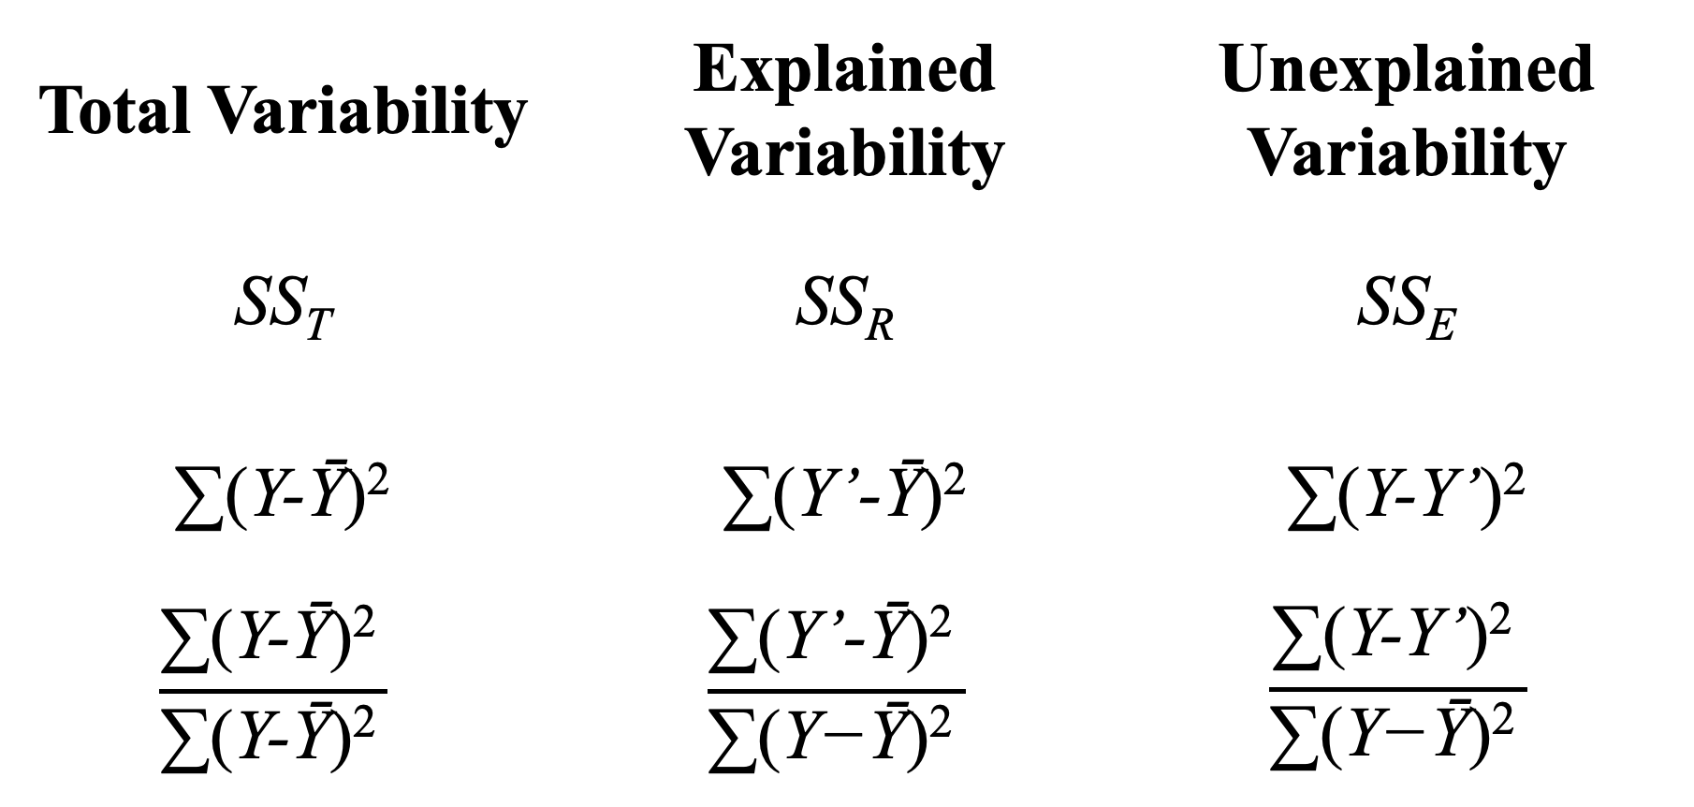
Variability Explained w/ Sums of Squares
Total Variability | Explained Variability | Unexplained Variability
SS_{T} | SS_{R} | SS_{E}
∑(Y-Ȳ)² | ∑(Y’-Ȳ)² | ∑(Y-Y’)²
$$\frac{\text{∑(}\text{Y}\text{−Ȳ}\text{)}\text{2 }}{\text{∑(}\text{Y}\text{−Ȳ}\text{)}\text{2 }}$$ | $$\frac{\text{∑(}\text{Y}\text{’−Ȳ}\text{)}\text{2 }}{\text{∑(}\text{Y}\text{−Ȳ}\text{)}\text{2 }}$$ | $$\frac{\text{∑(}\text{Y}\text{−}\text{Y}\text{’}\text{)}\text{2 }}{\text{∑(}\text{Y}\text{−Ȳ}\text{)}\text{2 }}$$
X̄ = 5.0000, Ȳ = 6.0000, SD_{x} = 3.0000, SD_{y} = 2.0000, r = 0.7500, b_{y} = 0.5000, b_{x} = 1.1250, a_{y} = 3.5000, a_{x} = -1.7500

Slide 70
Variability Explained w/ Sums of Squares
Total Variability | Explained Variability | Unexplained Variability
SS_{T} | SS_{R} | SS_{E}
∑(Y-Ȳ)² | ∑(Y’-Ȳ)² | ∑(Y-Y’)²
$$\frac{\text{∑(}\text{Y}\text{−Ȳ}\text{)}\text{2 }}{\text{∑(}\text{Y}\text{−Ȳ}\text{)}\text{2 }}$$ | $$\frac{\text{∑(}\text{Y}\text{’−Ȳ}\text{)}\text{2 }}{\text{∑(}\text{Y}\text{−Ȳ}\text{)}\text{2 }}$$ | $$\frac{\text{∑(}\text{Y}\text{−}\text{Y}\text{’}\text{)}\text{2 }}{\text{∑(}\text{Y}\text{−Ȳ}\text{)}\text{2 }}$$
X̄ = 5.0000, Ȳ = 6.0000, SD_{x} = 3.0000, SD_{y} = 2.0000, r = 0.7500, b_{y} = 0.5000, b_{x} = 1.1250, a_{y} = 3.5000, a_{x} = -1.7500

Slide 71
Standard Error of Regression (SD_{Y’ or} SD_{Y-Y’} )
r: Standardized measure of association between X and Y
r²: Proportion (or percent when x100) of variability accounted for in Y by variability in X
Wellness Score
Hours Exercising

Slide 72
Lecture Outline
Regression Conceptually
Computing Regression Lines
Standard Error of the Regression Line
Explained Variability
Formal Report

Slide 73
Formal Report
We investigated the relationship between hours of exercise (x̅ = 5.00, SD_{X} = 3.00) and a person’s wellness (y̅ = 6.00, SD_{Y} = 2.00) in eight individuals, see Figure 1. There was a strong, positive, linear relationship between hours of exercise and wellness (r = 0.75, b_{y} = 0.50, a_{y} = 3.50, SD_{Y’} =1.32, b_{x} = 1.13, a_{x} = -1.75, SD_{X’} = 1.98), which explained 56% of variability in our data. In summary, increased hours of exercise was associated with increased wellness.
Wellness Score
Hours Exercising
Figure 1. Association between hours of exercise and wellness scores. Red line corresponds to a regression line for predicting wellness from hours of exercise and blue line corresponds to a regression line for predicting hours of exercise from wellness.

Slide 74
Formal Report
We investigated the relationship between hours of exercise (x̅ = 5.00, SD_{X} = 3.00) and a person’s wellness (y̅ = 6.00, SD_{Y} = 2.00) in eight individuals, see Figure 1. There was a strong, positive, linear relationship between hours of exercise and wellness (r = 0.75, Y’ = 3.50 + 0.50(X), SD_{Y’} =1.32, X’ = -1.75 + 1.13(Y), SD_{X’} = 1.98), which explained 56% of variability in our data. In summary, increased hours of exercise was associated with increased wellness.
Wellness Score
Hours Exercising
Figure 1. Association between hours of exercise and wellness scores. Red line corresponds to a regression line for predicting wellness from hours of exercise and blue line corresponds to a regression line for predicting hours of exercise from wellness.

Slide 75
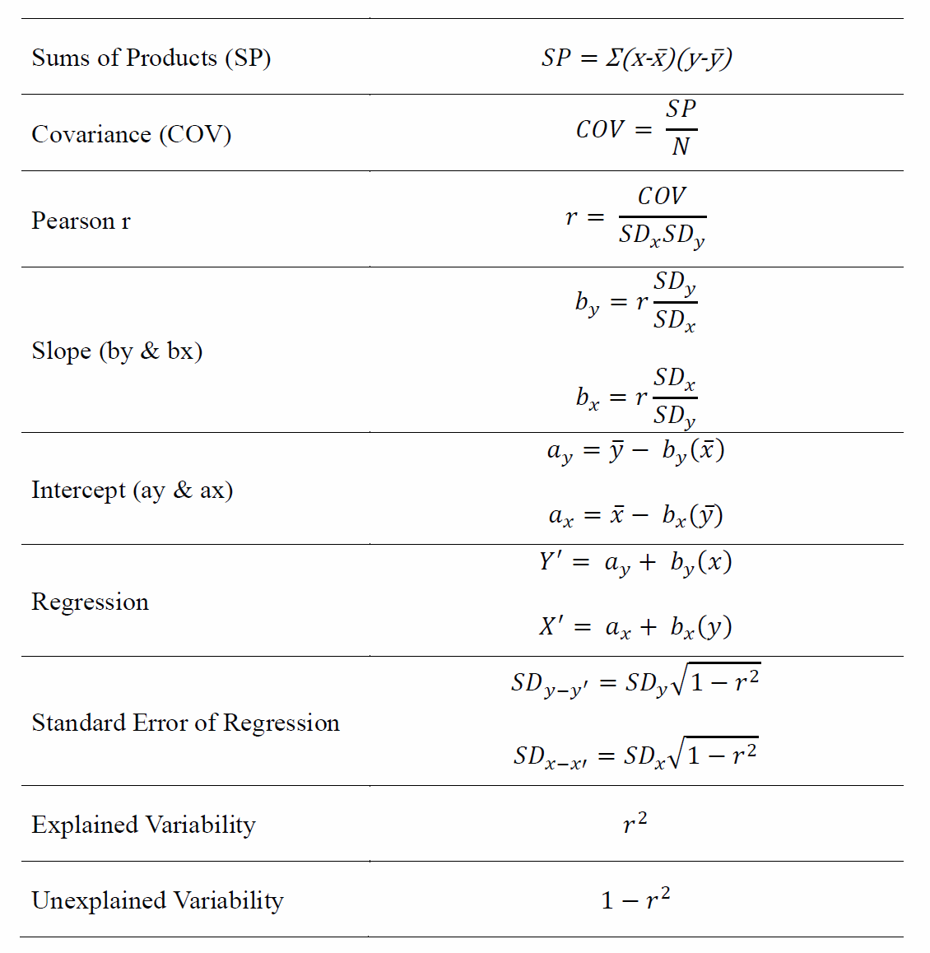

Slide 76
Final Notes on Regression
You will not be tested on this slide
Regression is a type of machine learning (ML)
Predictive ML: Model that predicts a continuous value
E.g., predict your final exam score based on your last midterm
This is what we did
Classification ML: Model that predicts a categorical outcome
E.g., classify whether you have diabetes or not
Can be done with a logistic regression, which is a modified linear regression

Slide 77
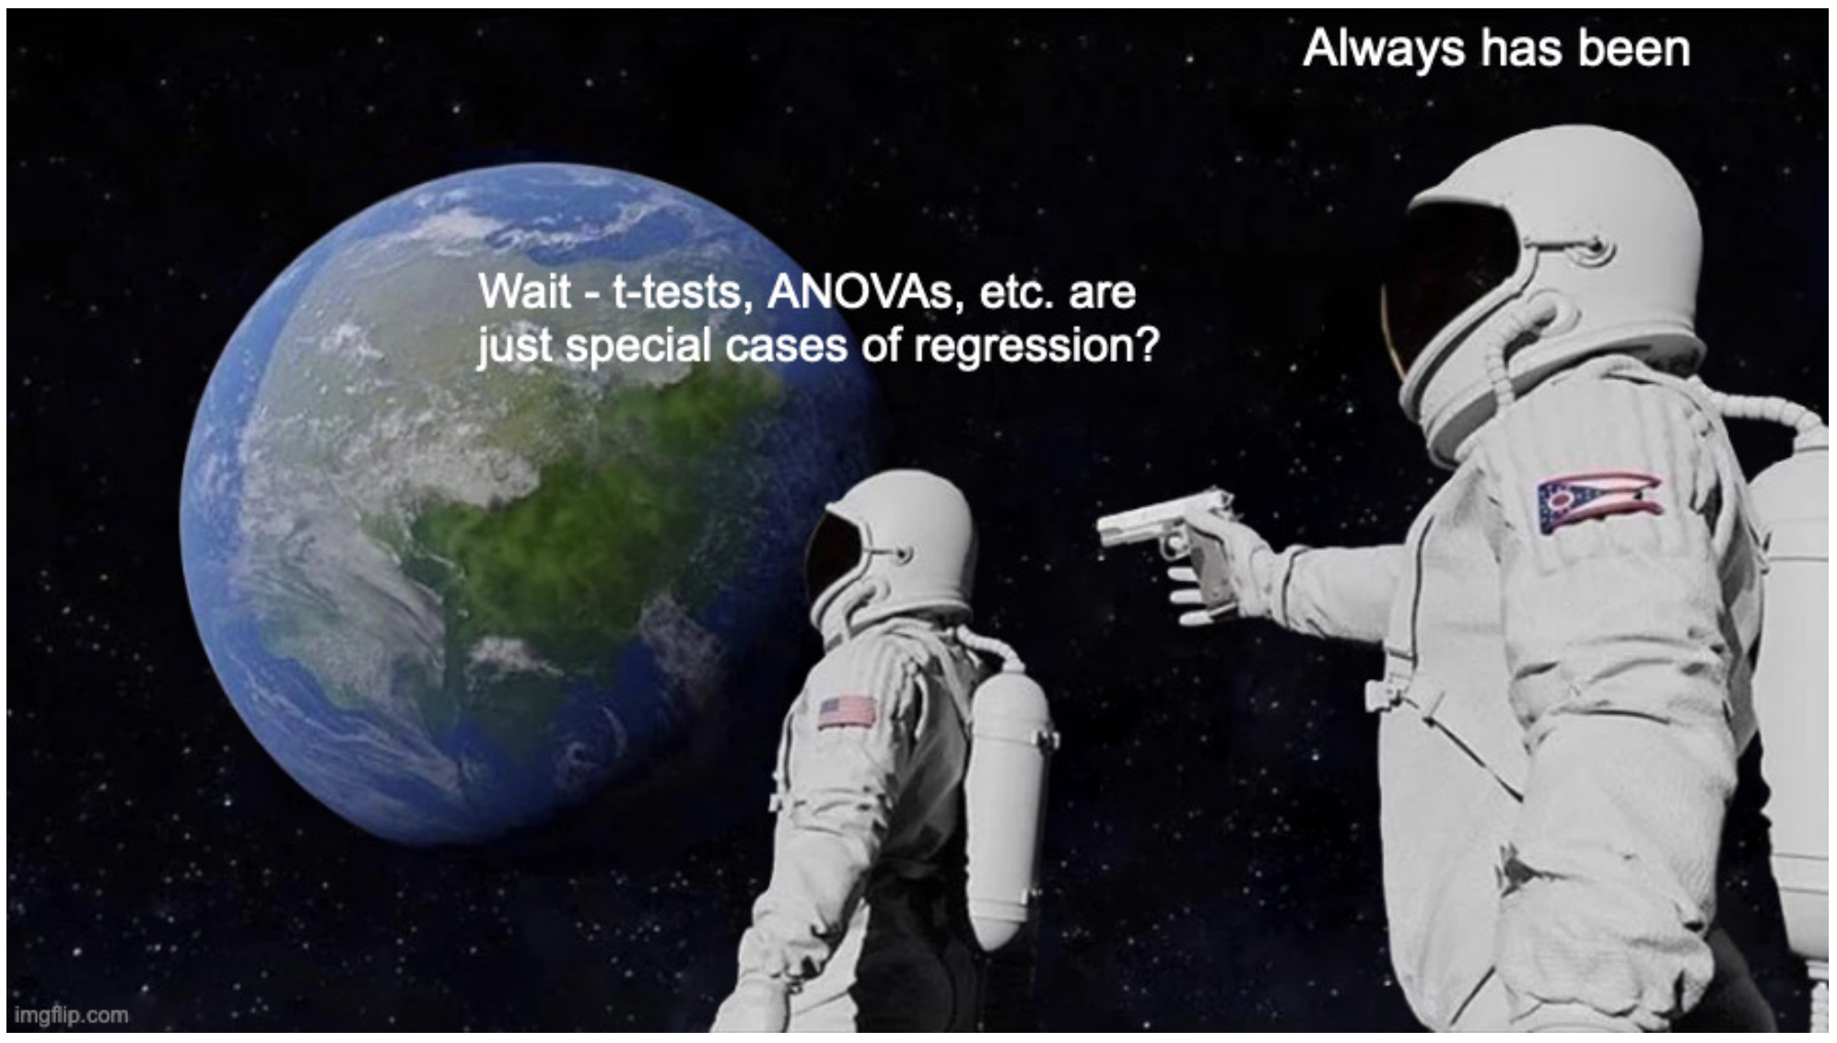
Final Notes on Regression
You will not be tested on this slide
Regression can handle any inferential test you will learn in Psyc 300A and Psyc 300B
E.g., T-Tests (300A), ANOVAs (300B)
It can also handle very complex designs
E.g., linear mixed-effects models (not covered in Psyc 300A/B)

Slide 78
Extra Resources

Slide 79
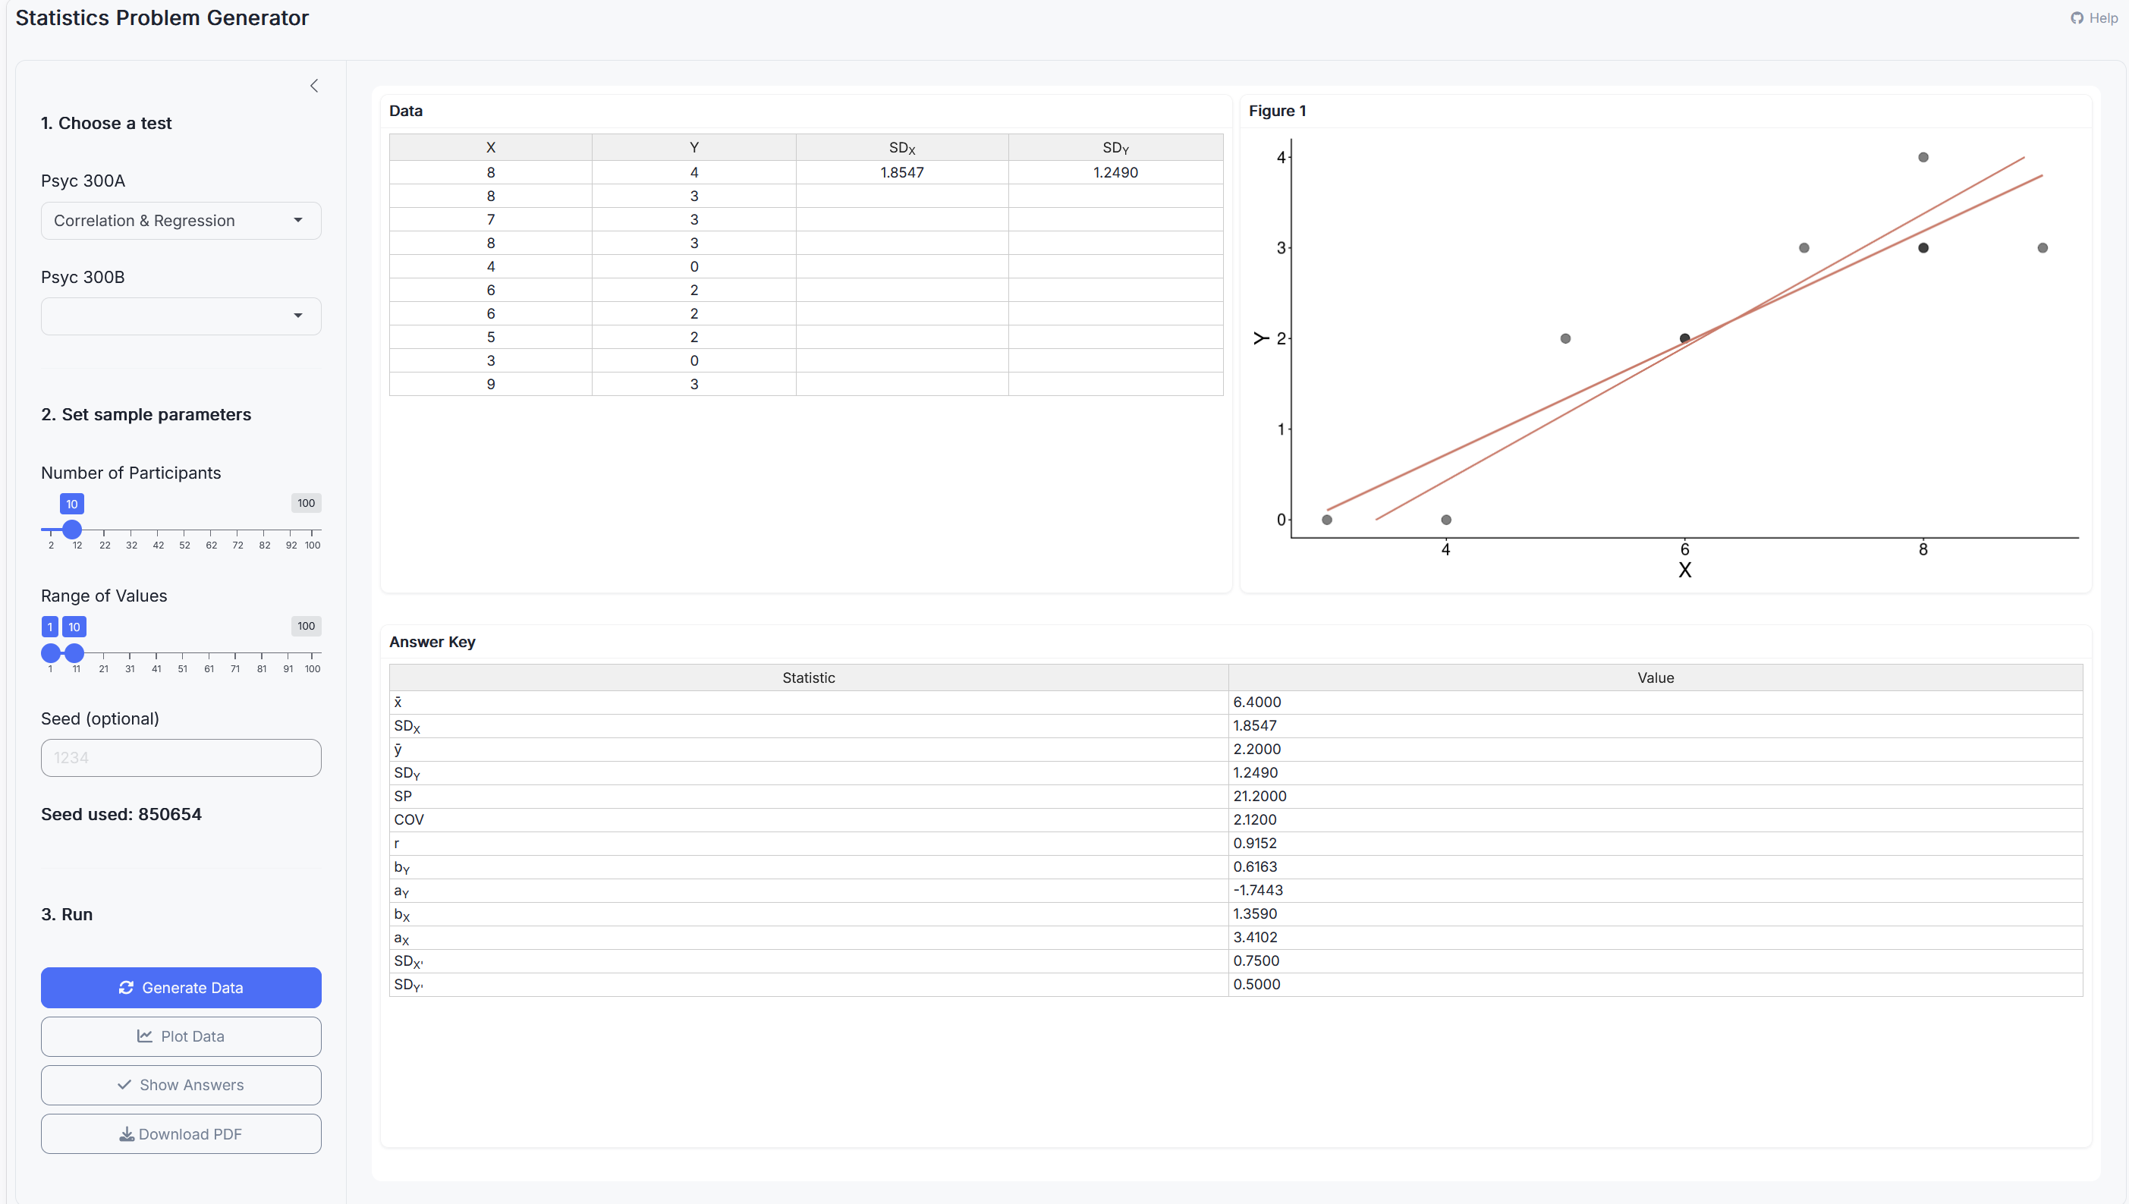
Stats Problem Generator
https://chadcwilliams.shinyapps.io/StatsProblemGenerator/

Slide 80
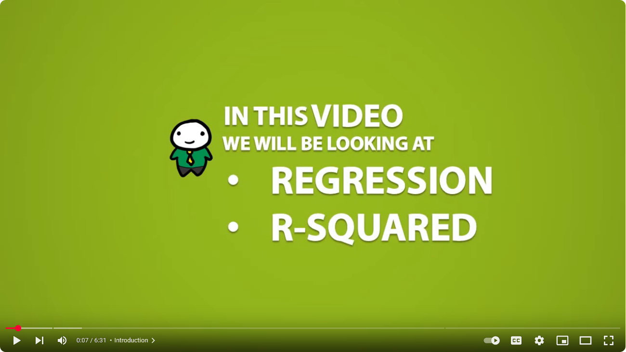
Extra Resources

